Slide 1
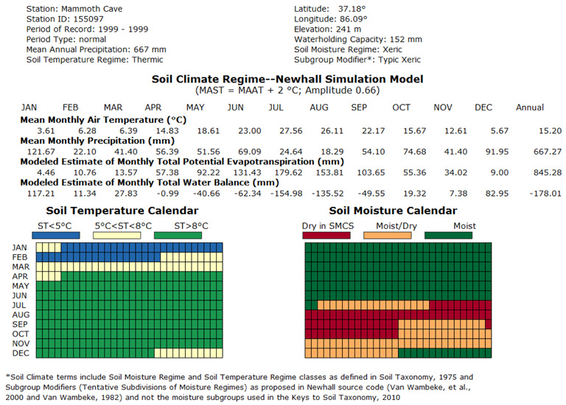
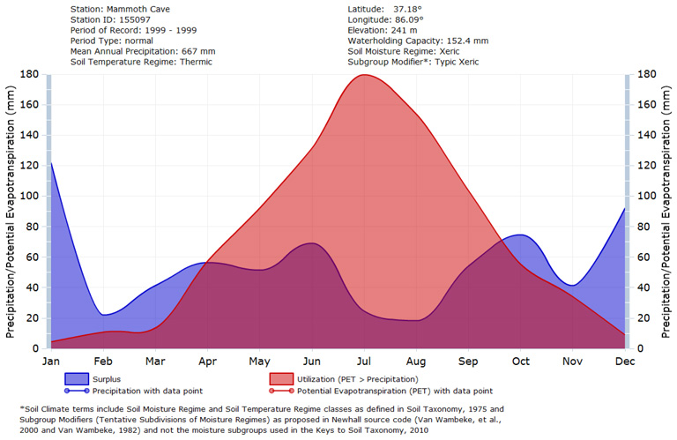
Java Newhall Simulation Model – A Traditional Soil Climate Simulation Model July 12, 2012
http://soils.usda.gov/technical/classification/jNSM/index.html
Larry West, National Research Leader, USDA-NRCS NSSC, Lincoln, NE
S. W. Waltman, Soil Scientist, USDA-NRCS NSSC-Geospatial Research Unit, Morgantown, WV
Notes:
A bit about myself for those I have not met. I have an MS in Soil Genesis and Morphology from Penn State and 28 years experience in soil survey, the last 20 spent working with simulation modelers. Much of my current work deals with gridded SSURGO and making USDA soil geographic data accessible and easy to use by modelers. In the past, I have served as the data steward for the Dominant Soil Orders and Suborders of the US (1999), Major Land Resource Areas of the US, and helped publish the State Soil Geographic Database (STATSGO) in 1994 and General Soil Map of the US (STATSGO2) in 2006.
I am not an expert in Soil Climate and do not wish to suggest that I am in giving this presentation today. However I have learned a lot about the weather station record and soil climate modeling assumptions during development of the jNSM software with the Penn State Center of Environmental Informatics as I managed the CESU Agreement. I defer to Dr. West and other NSSC staff with more experience and expertise in Soil Taxonomy than I on that topic.
This afternoon, Dr. West and I hope to share a little background on the jNSM climate model, how to operate the software, and apply in a soil climate study. We will use Mammoth Cave National Park as our soil climate case study.

Slide 2
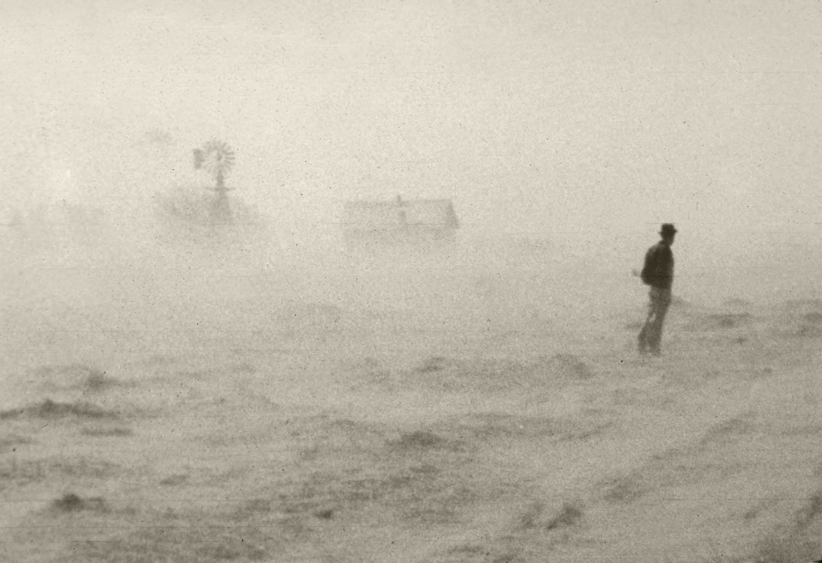
Some Observations…
Climate is a major driving force of soil processes and behavior (properties); past and present
Climate has been treated as static in soil classification & soil surveys
Difficult to handle scale, resolution, and time; mesoscale processes and microclimates
Soil Taxonomy (1999) defines “normal years” in relation to long-term (30 yrs or more) precipitation expressed on a mean annual and mean monthly basis
jNSM provides a systematic and quantitative approach to characterizing soil climate regime; can provide clues about more variable soil landscapes and trends through time; can help recognize rainshadows and defining climate criteria in ecological site descriptions
Climographs represent soil processes throughout the calendar year—number of leaching events and the intensity of leaching, translocation of clays, periods of drying & clay deposition, vernal pool and playa behavior, and provide a description of weathering environments; should be attached to typifying pedons
...
Photo by USDA-NRCS
C. Warren Thornthwaite Source: The Climates of North America: According to a New Classification in Geographical Review, Vol. 21, No. 4 (October., 1931, pp. 633-655)

Slide 3
Soil Temperature Regime Basics* Mean Annual Soil Temperature (MAST) 50 cm depth or lithic/paralithic contact
Soil Taxonomy (Ag Handbook 436 1975, 1999)
Gelic [Pergelic]
Cryic
Frigid
Mesic
Thermic
Hyperthermic
*Isofrigid
*Isomesic
*Isothermic
*Isohyperthermic
[< 0ºC
Permafrost if moist; dry frost if not moist]
> 0ºC < 8ºC
> 0ºC < 8ºC
Warmer summer soil temp than Cryic
> 8ºC < 15ºC
> 15ºC < 22ºC
> 22ºC
MSST
Mineral soils not saturated during summer and
-No O horizon: <15ºC
-O horizon: <8ºC
or
Mineral soils saturated during summer and
-No O horizon: <13ºC
-O horizon or Ap that is also a histic epipedon: <6ºC
or
Organic soils: <6ºC
< 0ºC
In gelic suborders and great groups; < 1ºC in Gelisols
KST, 2010
*Iso-
Mean summer – mean winter soil temp < 5ºC difference
(<6ºC in 1999)
*Iso-
Mean summer – mean winter soil temp < 5ºC difference
(<6ºC in 1999)
*Iso-
Mean summer – mean winter soil temp < 5ºC difference
(<6ºC in 1999)
*Iso-
Mean summer – mean winter soil temp < 5ºC difference
(<6ºC in 1999)
Cold
Hot
[1975 term]
* For more detail see ST 1975, 1999
Notes:
A quick review of the basics of Soil Temperature and Soil Moisture Regimes and a bit of history on Soil Taxonomy (1975 and 1999). This diagram illustrates Soil Taxonomy Soil Temperature Regime with simplified definitions, organized from Cold (left) to Hot (right). For details, see Soil Taxonomy and Keys to Soil Taxonomy. Note: in 1975 a combination of Cryic temperature regime and Ustic moisture regime was not considered and NSM/jNSM returns an UNDEFINED subgroup modifier for this condition. Also note, in 1999 the Iso- definitions were refined from < 5 degrees C to < 6 degrees C (to include a 5 degree C difference between mean monthly summer and winter soil temperatures). The gelic soil temperature regime was added to soil taxonomy with the publication of the 11th edition of the Keys to Soil Taxonomy in 2010 (KST, 2010).

Slide 4
Soil Moisture Regime Basics 1), 2)
Soil Taxonomy (Ag Handbook 436 1975, 1999)
Aquic and peraquic SMRs are not considered
in NSM or jNSM
Soil Moisture Control Section = SMCS
Perudic
Perudic
Wet
Precipitation exceeds ET in all months
-Soil is always moist
Typic Udic
Udic
Dry < 90 cumulative days or
dry in all parts < 45 consecutive days in summer
See ST 1975, 1999 and KST 2010
Criteria for SMRs are for “normal” years only
Dry Temp Udic
Wet Temp Ustic
Ustic - *No Ustic & Cryic in 1975
Dry in some part for ≥ 90 cumulative days, but dry in all parts for < 45 consecutive days in summer
Aquic Moisture Regime is defined by saturation and reduction and connoted by the presence of redoximorphic features
Typic Temp Ustic
Aquic
Xeric Temp Ustic
Xeric
Typic Xeric
Dry in all parts for > 45 consecutive days in summer and moist in all parts > 45 consecutive days in winter
Dry Xeric
Weak Aridic
Aridic
Dry > half cumulative days when soil temp > 5ºC and
Moist < 90 consecutive days when soil temp > 8ºC
Typic Aridic
Dry
Extreme Aridic
Notes:
This diagram illustrates Soil Taxonomy Moisture with simplified definitions, organized from Wet (top) to Dry (bottom). For details, see Soil Taxonomy and Keys to Soil Taxonomy. Note: In ST, 1975, 1999 a combination of a cryic soil temperature regime and the ustic moisture regime was not considered and NSM/jNSM returns an UNDEFINED subgroup modifier for this condition. As of 2006, these two regimes are now permitted together.
Note: NSM and jNSM models do not consider the aquic or peraquic soil moisture regimes.

Slide 5
Soil Moisture Regime Basics 1), 2)
Van Wambeke (1982) Proposed Subdivisions Temperate Climates; Tropical Climates (“Trop-”) not listed here
Soil Taxonomy (Ag Handbook 436 1975, 1999)
Soil Moisture Control Section = SMCS
Perudic
Perudic
Precipitation exceeds ET in all months
-Soil is always moist
Precipitation exceeds ET in all months
-Soil is always moist
Typic Udic
Udic
Dry < 90 cumulative days or
dry in all parts < 45 consecutive days in summer
Dry Tempudic
Wet Tempustic
Ustic - *No Ustic/Cryic in 1975)
Dry in some part for ≥ 90 cumulative days, but dry in all parts for < 45 consecutive days in summer
Aquic Moisture Regime is defined by saturation and reduction and connoted by the presence of redoximorphic features
Typic Tempustic
See ST 1975, 1999 and KST 2010
Criteria for SMRs are for “normal” years only
Aquic
Xeric Tempustic
Xeric
Typic Xeric
Dry in all parts for ≥ 45 consecutive days in summer and moist in all parts > 45 consecutive days in winter
Dry Xeric
Weak Aridic
Aridic
Dry > half cumulative days when soil temp > 5ºC and
Moist < 90 consecutive days
when soil temp > 8ºC
Typic Aridic
Extreme Aridic
Notes:
When you run jNSM you will see some “new” old terms show up in the Subgroup Modifier box. These terms were proposed to further subdivide Soil Taxonomy moisture regimes in the 1980’s by Dr. Armand Van Wambeke (Cornell University, International Pedologist) . He proposed and defined these terms while doing USAID sponsored work in Africa, South America, Central America and the Caribbean, and Asia. The jNSM model is based on the 1991 Cornell NSM model code that Dr. Van Wambeke developed. See the jNSM v 1.5.1 User Guide Appendix E Useful References, for a portion of his African publication where these term are defined. Only temperate climate terms (“Temp-”) are included in this diagram. Tropical climate terms (“Trop-”) are also provided and are defined in the Africa publication.

Slide 6
Soil Moisture Regime Basics*
Van Wambeke (1982) Proposed Subdivisions Temperate Climates; Tropical Climates not listed here
Soil Taxonomy (Ag Handbook 436 1975, 1999)
Soil Moisture Control Section = SMCS
Perudic
Perudic
Precipitation exceeds ET in all months of normal years
-Soil is always moist (same as ST)
Wet
Precipitation exceeds ET in all months of most years
always moist
Precipitation exceeds ET in all months
-Soil is always moist
Dry in some or all parts < 30 cumulative days
Udic
Typic Udic
Dry < 90 cumulative days or
dry in all parts < 45 consecutive days in summer
Dry Tempudic
Dry in some or all parts > 30 cumulative days
Wet Tempustic
Moist in all parts > 45 consecutive d in winter and not dry ≥ 45 consecutive d in summer
Ustic - *No Ustic/Cryic in 1975)
Dry in some part for ≥ 90 cumulative days, but dry in all parts for < 45 consecutive days in summer
Aquic
Dry in some or all parts ≥ 90 cumulative d; not dry in all parts > half cum. d when soil temp > 5ºC
Typic Tempustic
Xeric Tempustic
Meets moisture criteria for the Xeric SMR but has a MAST ≥ 22ºC (i.e., hyperthermic STR)
Xeric
Typic Xeric
Dry in all parts 45 to ≤ 90 consecutive days in summer
Dry in all parts for ≥ 45 consecutive days in summer and moist in all parts > 45 consecutive days in winter
Dry Xeric
Dry in all parts > 90 consecutive days in summer
Weak Aridic
Moist in some or all parts > 45 but < 90 consecutive days when soil temperature > 8ºC
Aridic
Dry > half cumulative days when soil temp > 5ºC and
Moist < 90 consecutive days when soil temp > 8ºC
Typic Aridic
Typic Aridic
Moist in some or all parts < 45 consecutive days when soil temperature > 8ºC
Dry
Extreme Aridic
Completely dry during the entire year
Extreme Aridic
Notes:
Simplified definitions for Van Wambeke’s proposed soil moisture regime subdivisions are included in this diagram. Note that the last portion of the proposed subdivision term indicates its parent soil moisture regime e.g., “Wet Tempustic” is a subdivision of the ustic moisture regime. See Appendix E of the jNSM v1.5.1 User Guide for Dr. Van Wambeke’s Africa publication for details. The 1982 Africa publication states, “The subdivisions of the moisture regimes are only tentative. They have no official status, and are not an integral part of Soil Taxonomy. They are only given as guidelines to assist in the definitions of new subgroups or other taxa.” Also note, only temperate climate terms (“Temp-”) are listed in this slide. The Africa publication also gives tropical climate terms (“Trop-”) and their definitions.

Slide 7
Newhall Simulation Model (NSM) Assumptions
Developed by Dr. Franklin Newhall
Published in 1972
Model is not a sophisticated simulation of water movement through a soil
Soil is regarded as a reservoir with fixed capacity (200 mm Available Water Capacity (AWC) is default; can be changed)
Water is added to soil by precipitation; removed by evapotranspiration
When the bucket is full, no more water can be added
Excess precipitation is lost as runoff or leaching
Potential evapotranspiration from Thornthwaite model
Mean annual soil temperature = mean annual air temperature + offset (2.5º C is default; can be changed; See chapter 4, p. 108 in Soil Taxonomy, 1999, for more discussion of relationship between mean annual air temperature and mean annual soil temperature)
Notes:
The jNSM uses a default offset value of 2.5 degrees C. which is added to mean annual air temperature in the approximation of mean annual soil temperature. This default value may not be appropriate for soils in moist (i.e., humid) climates. The second edition of Soil Taxonomy suggests adding 1 degree C. to the mean annual air temperature to estimate mean annual soil temperature for much of the United States. For more information, see the discussion in chapter 4, page 108, Soil Taxonomy, 1999.

Slide 8
Soil Representation
8 X 8 matrix – 64 boxes
Each row holds 1/8 of total AWC
Depth not a variable
Accounted for in AWC
Each box holds 1/64 of total AWC
Fills from top
Empties with slants
Energy to remove water depends on
Matric potential (tension)
Depth
AWC
PWP
Water Content
Field
Capacity

Slide 9
Adding Soil Moisture
Precipitation
AWC
AWC
Water Content
Water Content

Slide 10
Depleting Soil Moisture
Order
Energy (PET equil)
29
7
4
2
1
1.7
1.4
1.2
1.1
1.1
1.0
1.0
1.0
37
8
5
3
1.1
1.1
1.0
1.0
9
6
1.1
1.0
AWC
10
3.6
1.1
AWC
4.0
1.4
64
36
5.0
2.0
Water Content
Water Content
1.0 – 1 mm water loss = 1 mm PET
5.0 – 1 mm water loss = 5 mm PET

Slide 11
Depleting Soil Moisture
AWC
Drying
AWC
Water Content
Water Content
Moist in all parts of MCS
Dry in some parts of MCS

Slide 12
Depleting Soil Moisture
AWC
Drying
AWC
Water Content
Water Content
Dry in all parts of MCS
Moist in all parts of MCS

Slide 13
AWC/WRD
Can be changed in model runs
Default is 200 mm
For 200 cm soil profile,
Available water capacity (AWC, WRD)= 0.1 cm³/cm³ = 0.1 cm/cm (sandy loam?)
80 mm AWC – 0.04 cm/cm (sand?)
For 50 cm soil profile,
Available water capacity = 0.4 cm³/cm³ = 0.4 cm/cm (no texture will meet)
80 mm AWC – 0.16 cm/cm (loam?)
Will impact calculations and soil moisture regime

Slide 14
Variable AWC (WRD)
Memphis (TN); fine-silty |  |  |  | Conlen (TX); coarse-loamy
Horizon | Depth | Texture | WRD | Horizon | Depth | Texture | WRD
 | cm |  | cm/cm |  | cm
Ap | 0-22 | sil | 0.26 | A | 0-25 | cl | 0.17
E | 22-41 | sil | 0.22 | Bk1 | 25-38 | c | 0.18
Bt1 | 41-74 | sicl | 0.22 | Bk2 | 38-102 | sil | 0.15
Bt2 | 74-109 | sicl | 0.24 | Bk3 | 102-145 | l | 0.10
Bt3 | 109-138 | sil | 0.25 | Bk4 | 145-203 | fsl | 0.11
Bt4 | 138-168 | sil | 0.23
BC | 168-200 | sil | 0.26

Slide 15
Variable AWC (WRD)

Slide 16
AWC Effects illustrated in jNSM Calendar Report
80 mm AWC – Dry Udic – 48 days dry in some are all parts
200 mm AWC – Udic – 16 days dry in some or all parts
J
J
Month
Month
D
D
1
30
1
30
1
Day of Month
Day of Month

Slide 17
Java Newhall Simulation Model (jNSM)
Developed by the Penn State Center for Environmental Informatics via CESU Agreement 2010-2011
Based on 1991 Van Wambeke NSM BASIC code, reflects ST rules at that time also includes Proposed Moisture Regime Subdivision terms (Van Wambeke, 1982)
See You Tube video of 1999 NSM simulation run on jNSM web page (Background)
Java application in a Flex wrapper that returns identical results as the 1991 BASIC code for same inputs
Added summer and annual water balance with interactive User Interface and reports
Standardized input and output parameters with dictionary
Input requires CSV files that can be easily created using Excel templates
Output stored in XML format that can be converted to CSV
Increased speed of single run from 3 minutes to 25 milliseconds
CCE approved for USDA use in 2012
Deployed to NRCS desktops 7/2012

Slide 18
Newhall Simulation Model (NSM) Requirements
Serially complete monthly precipitation and air temperature for a calendar year or years from a weather station (at least 20-25 days in a month)
Weather station metadata
Name
Code
Weather station network
Latitude/longitude
Start year
End year
Available Water Capacity (AWC) computed for the soil profile at or near the weather station (also called AWS)
MAST minus MAAT offset value (from SCAN or literature)
User metadata
Inputs must all share a common systems of units
All English (Non-SI) º F, inches AWC, inches precipitation
All Metric (SI) º C, mm AWC, mm precipitation
Need to be very mindful of units in data preparation and analysis

Slide 19
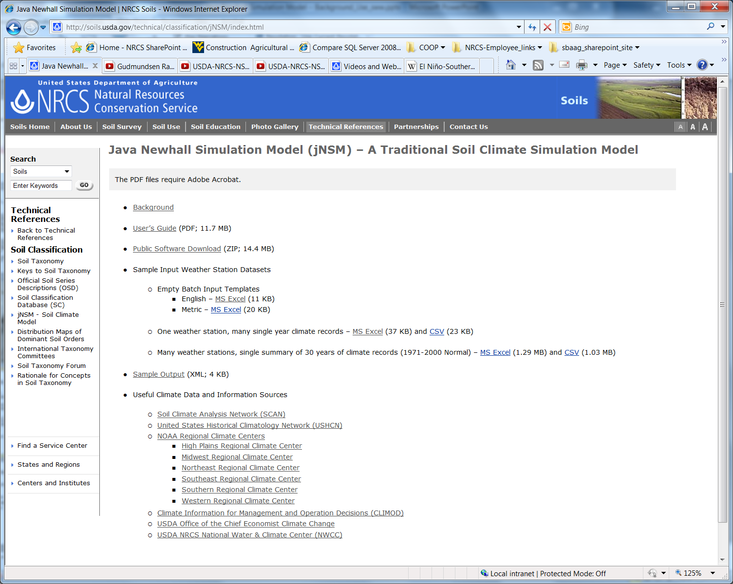
jNSM v1.5.1 Software
CCE
Installation
Start up
Data Entry
Running Model
Reviewing Output
Public
Installation
Start Up
Getting started…

Slide 20
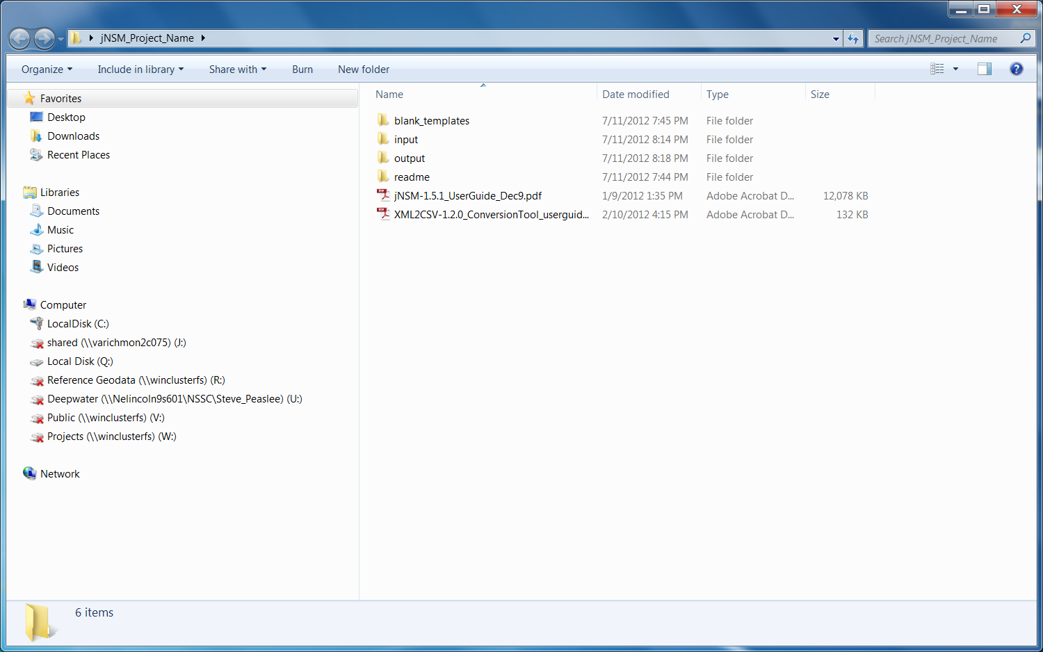
Recommended file management system for files related to jNSM projects:
/jNSM_v151_Project_Name/
/blank_templates/
/input/ *.xlsx, *.csv
/output/ *.xml, csv
/readme/ *.txt
/…user guides.pdf

Slide 21
User Guide
Demonstration
Tutorial Slide Set – Mammoth Cave National Park

Slide 23
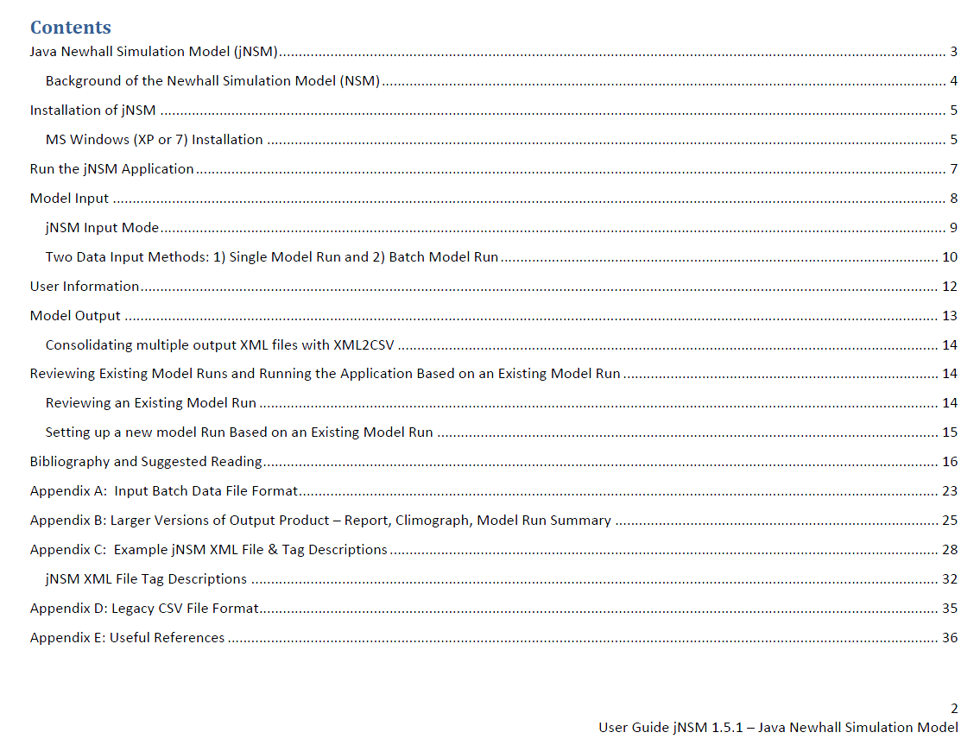

Slide 25
Note, this should read “June through August”, a correction will be made in the next edition of the jNSM User Guide.

Slide 26
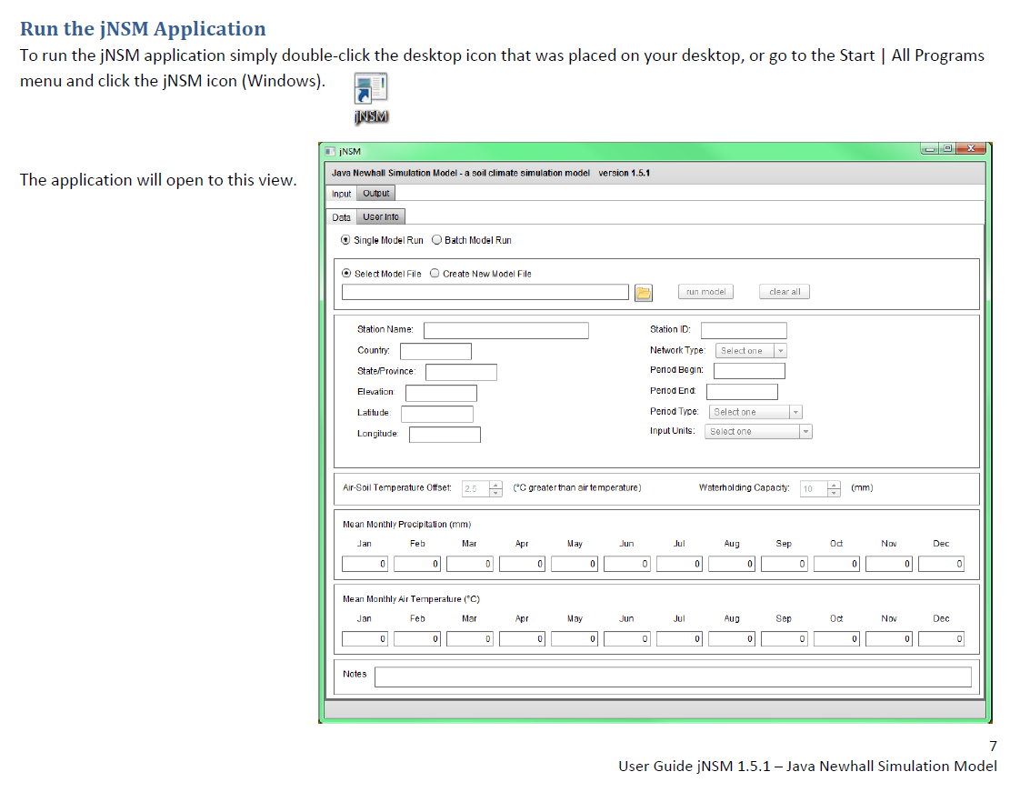

Slide 28
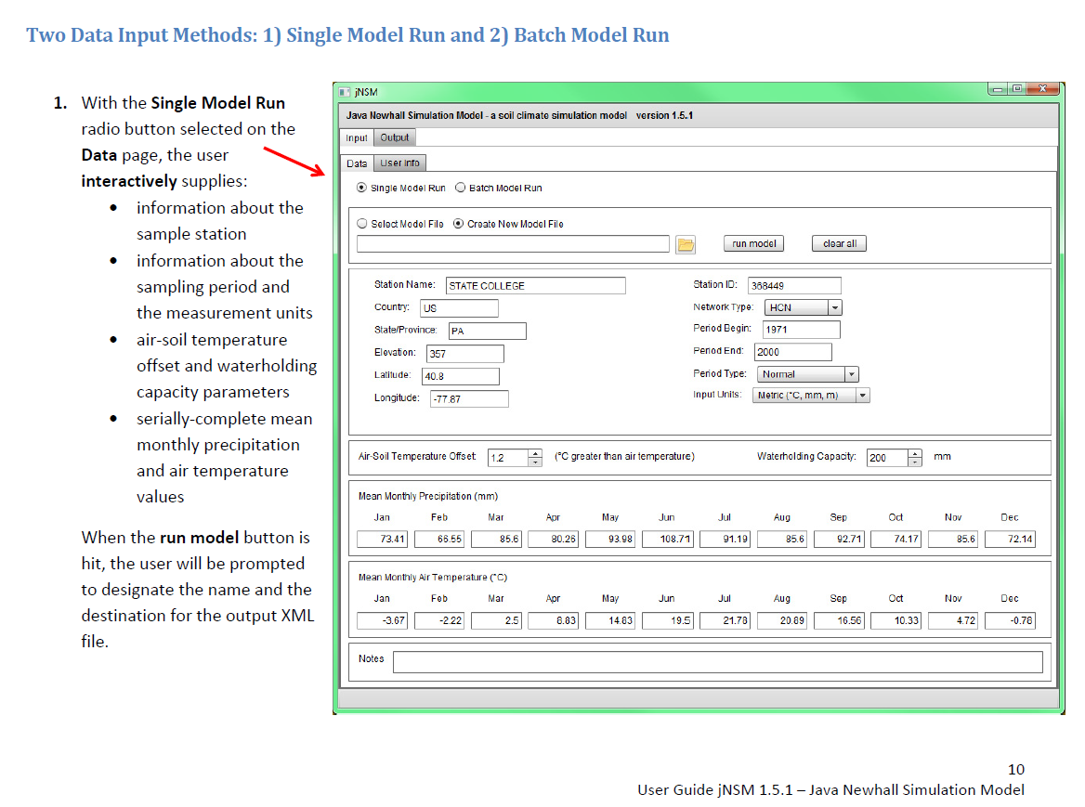

Slide 29
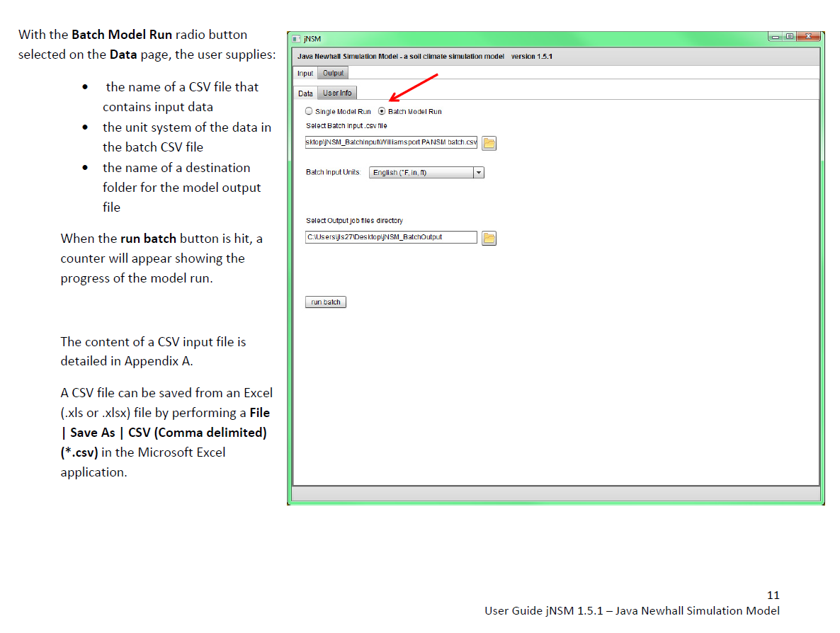

Slide 30
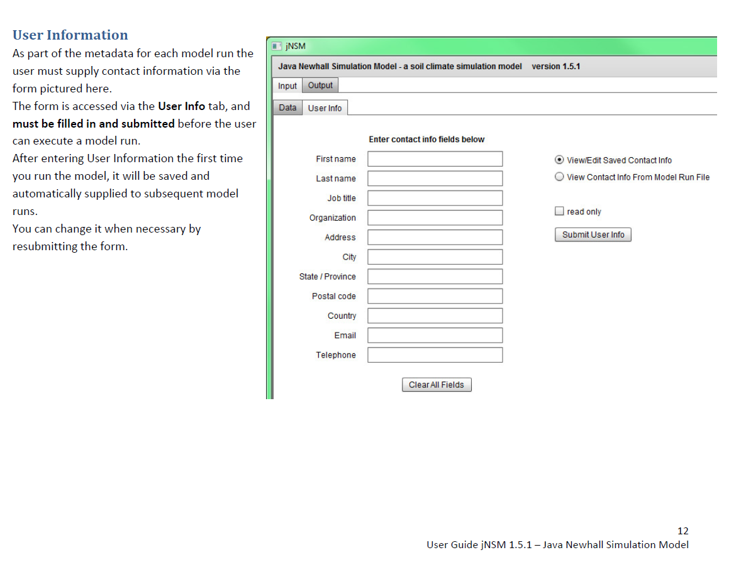

Slide 32
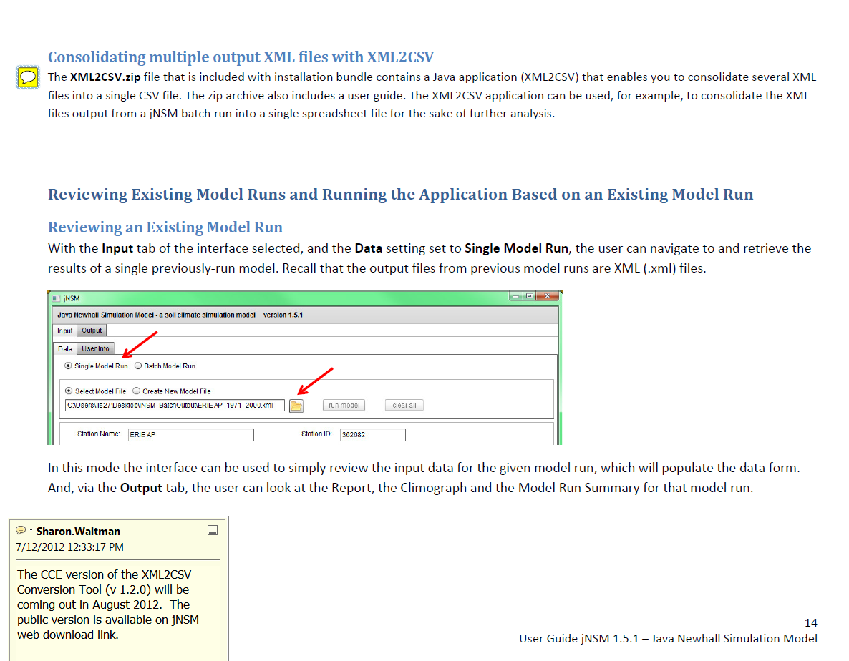

Slide 33
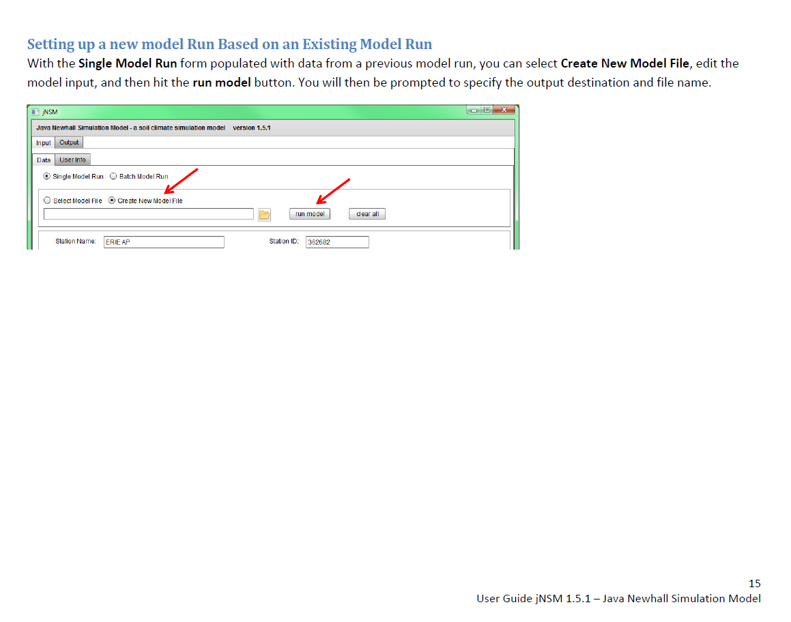

Slide 34
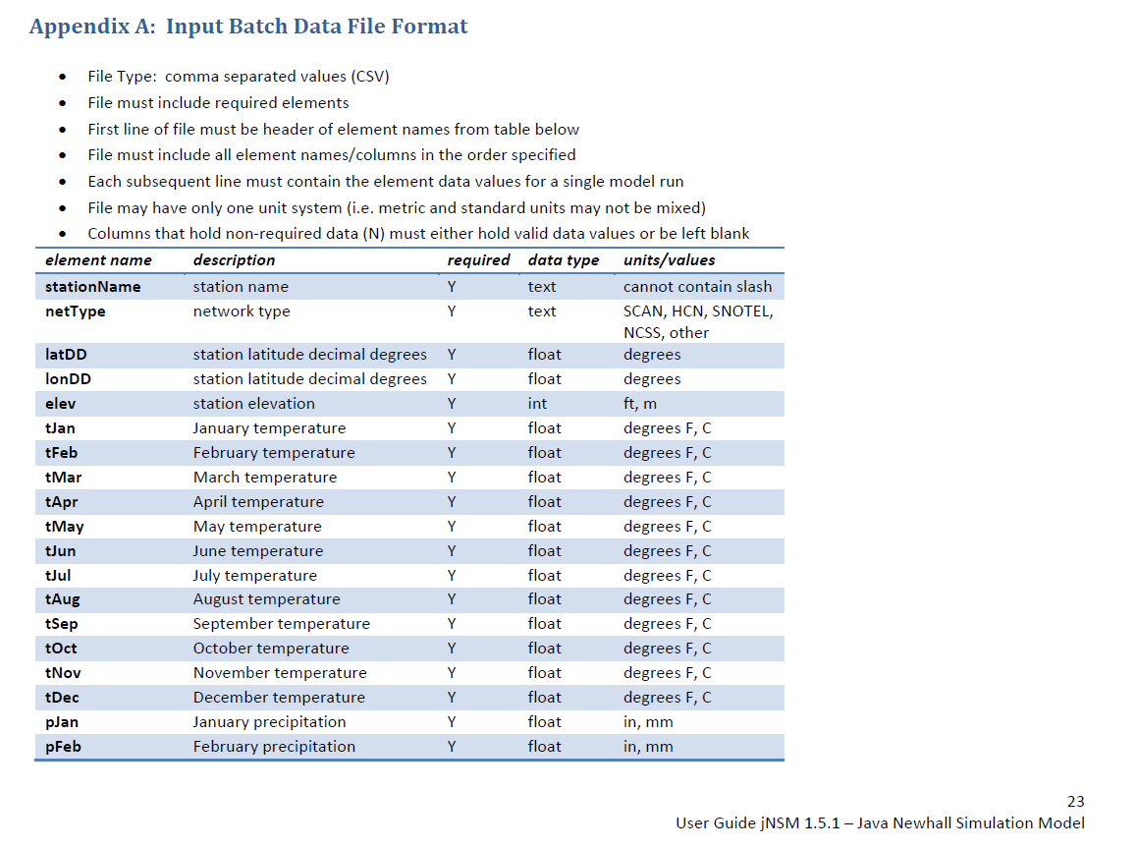

Slide 35
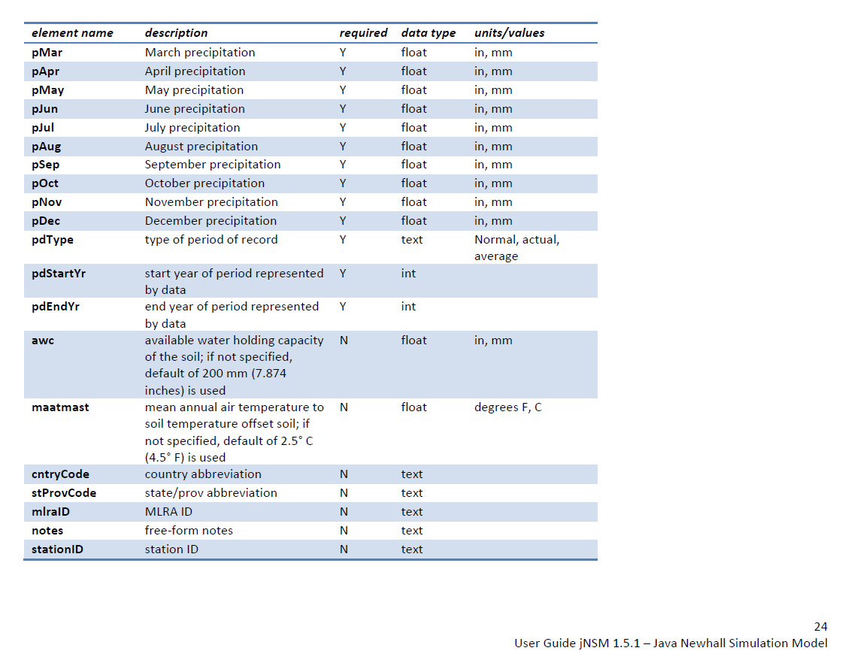

Slide 36
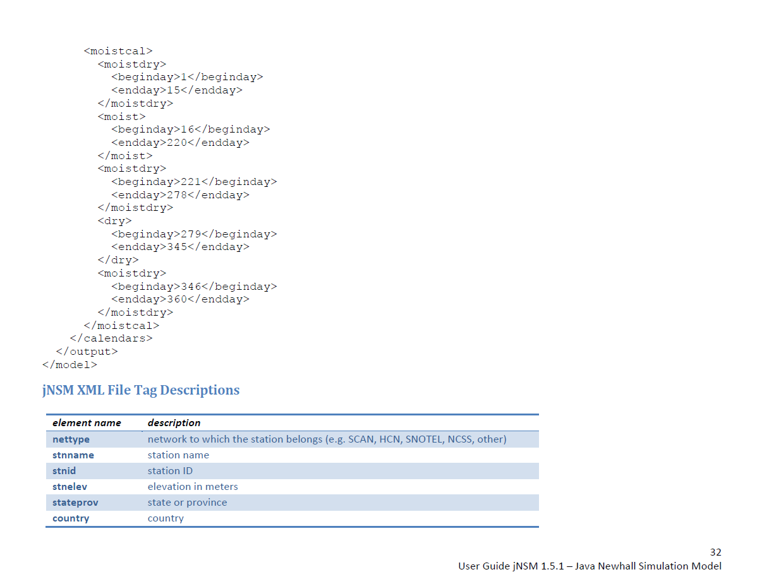

Slide 37
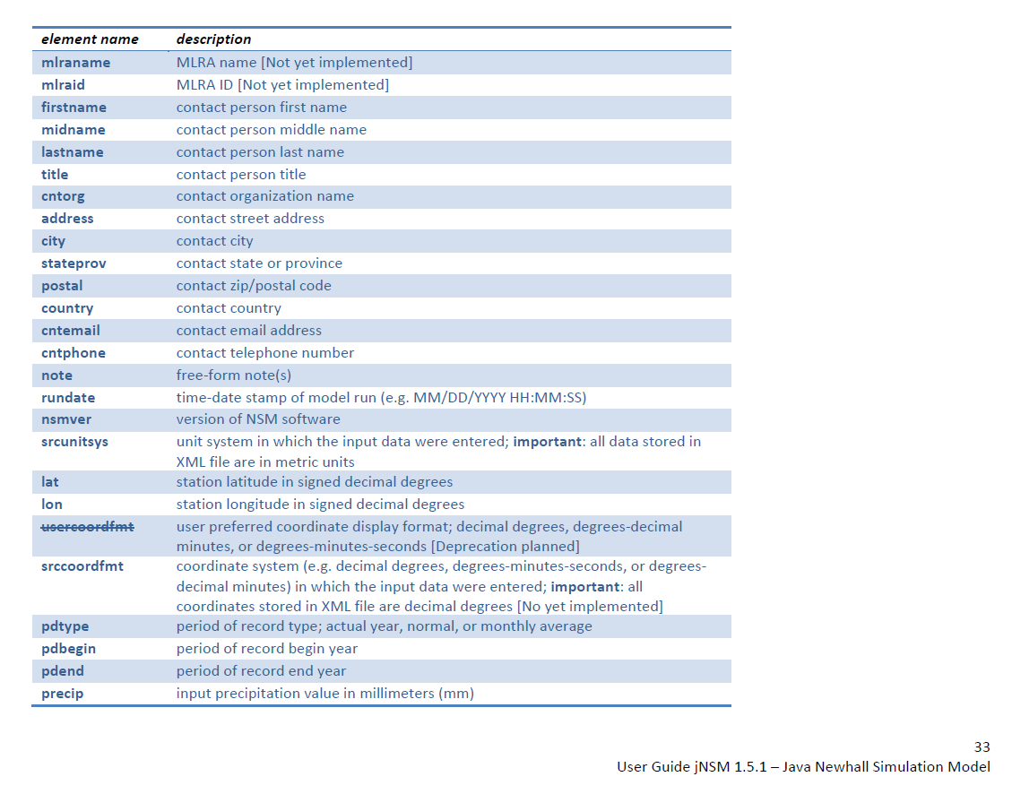

Slide 38
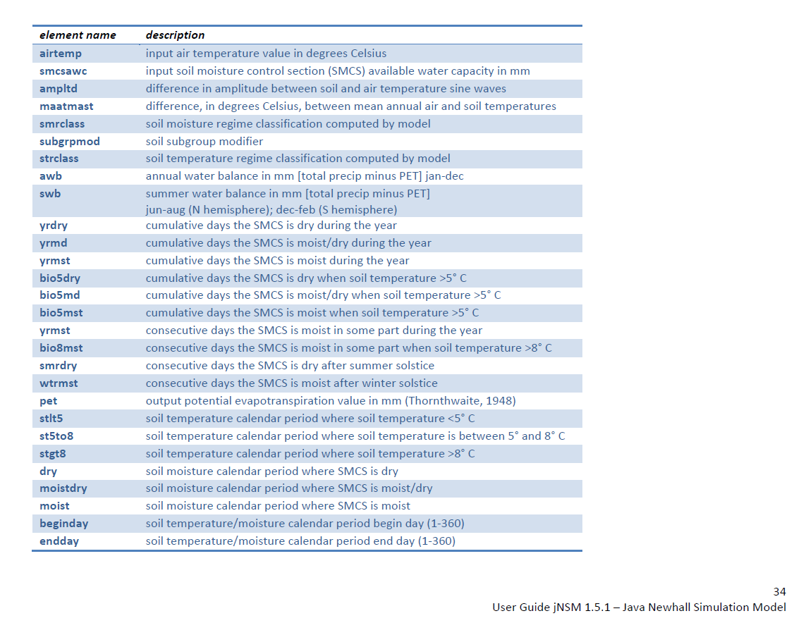

Slide 40
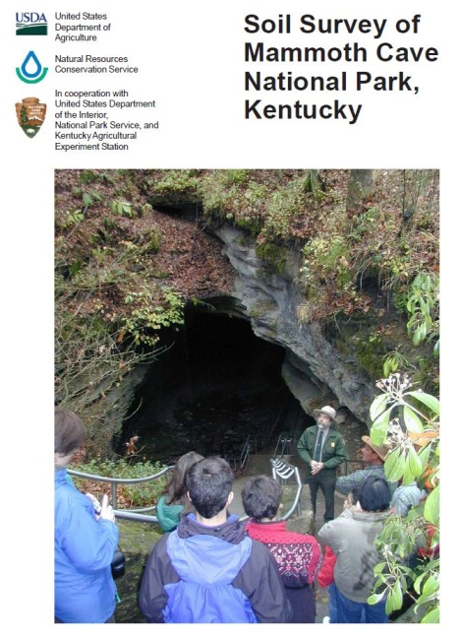
jNSM Tutorial Soil Climate Case Study Mammoth Cave National Park July 2012
Pete Biggam, Soils Program Coordinator National Park Service, Lakewood, CO
Sharon W. Waltman, Soil Scientist USDA-NRCS NSSC-Geospatial Research Unit, Morgantown, WV
William J. Waltman, Research Associate, West Virginia University, Morgantown, WV

Slide 41
Conducting a Soil Climate Study Mammoth Cave Case Study
Write hypothesis about climate regime study site (e.g. “Soil climate regime is Udic and soil temperature regime is Mesic” )
Review literature
Identify data sources and obtain weather station data for available individual years or summary of years within MLRA of study and neighboring MLRAs (e.g. MLRA 120A KY/IN Sandstone and Shale Hills and Valleys, Southern Part)
Soil Climate Analysis Network - SCAN at NWCC
Northeast Regional Climate Center - CLIMOD
US Historical Climatology Network - US HCN
Prepare MAST-MAAT offset parameter from SCAN or measurements from literature (avoid 1 or 2 year data logger studies)
Prepare jNSM input tables

Slide 42
Conducting a Soil Climate Study Mammoth Cave Case Study
Run jNSM Model
Examine results and compare with neighboring stations
Analyze yearly climate probabilities and generate moisture and temperature regime frequencies for study area
Review anomalous (outlier) years for impact of natural events such as hurricanes, degraded tropical storms, droughts, etc.
Identify long term trends and patterns in the data and re-evaluate original hypothesis

Slide 43
Mammoth Cave Climate Records and Drought Years –
Timeline Comparisons
Soil Climate Analysis Network or SCAN (2004 -2 011) – Daily Air Temp and 50cm Soil Temp
Northeast Regional Climate Center CLIMOD* (NWS COOP; 1934 – 2011) - Monthly Air Temp and Precip
US Historical Climatology Network (1895 – 2011) - Daily and Monthly Air Temp and Precip
NWS COOP Network 30 year Normal (1971 - 2000) Monthly Air Temp and Precip
*Requires subscription – NWCC may be able to assist
Nationally significant drought events – National Drought Mitigation Center, 2012
Ag and the Recent “Benign Climate” in MN, Baker et al, 1993 Bull. Amer. Meteo Soc. 74, 1035-1040
1895
1900
1934
1971
2000
1955
2004
2011
1974
Period of Benign Climate
8 yrs
78 yrs
117 yrs
30 yr Normal
1870
1880
1890
1910
1920
1930
1940
1950
1970
1980
1990
2010
2020
Tree ring
records
Dust Bowl Years
Notes:
Step 3. Identify data sources and obtain weather station data for available individual years or summary of years within MLRA of study and neighboring MLRAs
Soil Climate Analysis Network - SCAN ; US Historical Climatology Network - US HCN; US Climate US CRN; Local NCSS climate monitoring sensors. Note length of record varies significantly for each climate source. The SCAN length of record is 8 years, the CLIMOD record is 78 years, and the Historical Climatology Record is 117 years. Before 1895, climate records are scarce and other sources of supporting climate information are often used, including tree ring records and historical accounts.

Slide 44
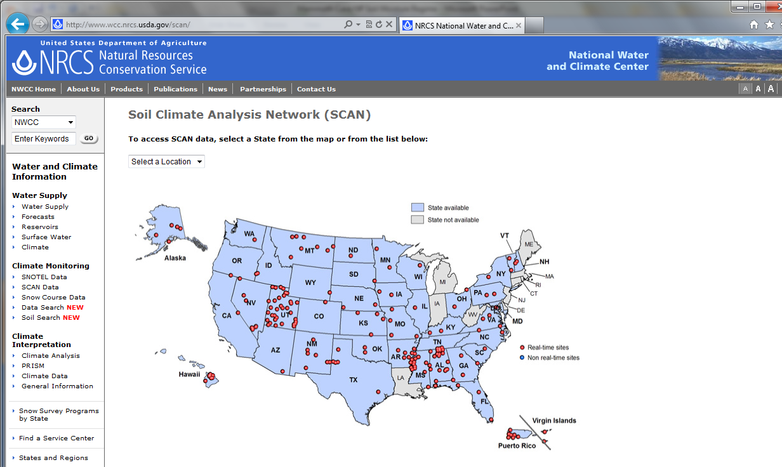
SCAN Data at the National Water and Climate Center
SCAN sites can provide base data for deriving the Air: Soil Temperature Offset; try to select one based on MLRA or similar physiographic province; EROS Data Center would not be representative of western South Dakota, just the Prairie Coteau
Ag Expt Stations were often the only sources of past soil temperature data
SCAN total precipitation is often under-reported; use nearby NWS Coop Station for precipitation
TAPS & WETS tables for 30 year normals that can provide input data for jNSM
SCAN sites have <30 yr records
EROS Data Center
Mammoth Cave SCAN Site
Nunn LTER & Torrington Expt Station
Notes:
SCAN sites are often co-located with other weather station networks that also monitor soil temperature and moisture. SCAN sites have < 30 year records. NWCC site also provides TAPS & WETS tables for 30 year Normals that can be used to provide input data for jNSM. Historically the TAPS tables with their 30 year Normal values often served as input to NSM in the 1990’s.

Slide 45
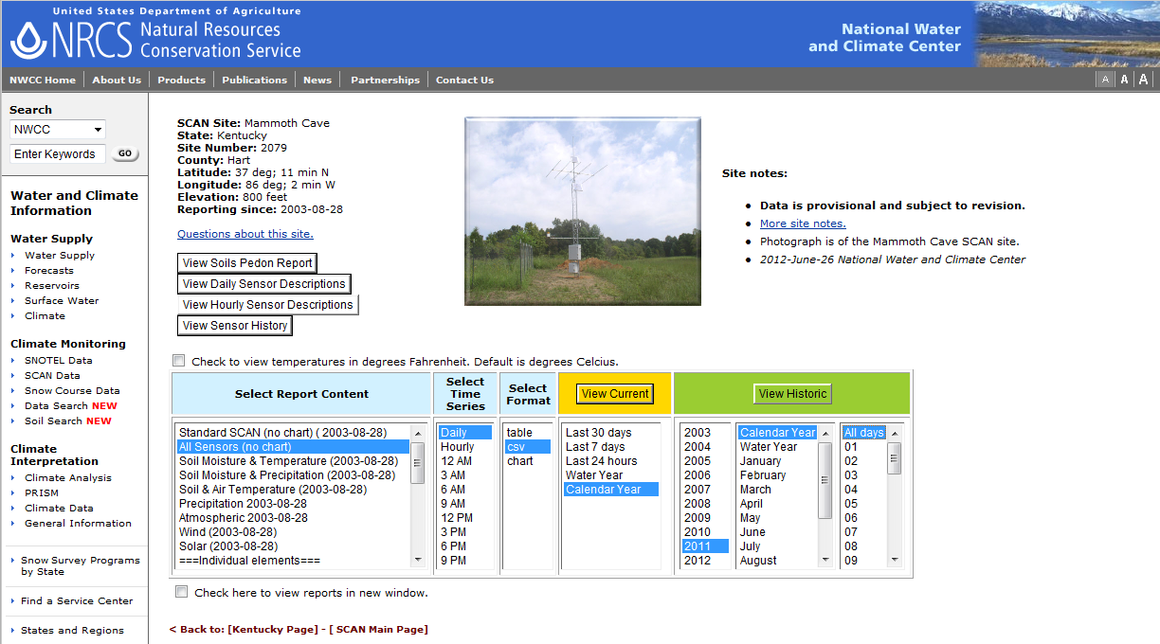
SCAN Data at the National Water and Climate Center
Mammoth Cave SCAN Site has data from 2003-2011; the interface allows you to download one year at a time; precipitation data is suspect in the colder regions
Download for “All Sensors; Daily, CSV, Calendar Year, and All Days”
Watch for dead sensors in the data, missing months and years for sensors
Some SCAN sites have multiple soil temperature sensors at various depths
Notes:
When downloading SCAN data suggested settings are highlighted in blue on screen for 2001 Calendar year. Need to choose, All Sensors (no chart) for full suite of information. Need to download daily values one year at a time, then summarize to monthly values for jNSM input. Soils Pedon Report can provide available water holding capacity inputs for jNSM (6 inches or 153 mm AWC was used based on Mammoth Cave NP SCAN soil profile data). Need to be careful of mixed English (Non-SI) and Metric (SI) units with SCAN data.

Slide 46
SCAN Site at Mammoth Cave National Park, KY 1/2011
Typical table (.csv) downloaded from SCAN site; comparing Tavg & STO at -20 in for the OFFSET
Site Id | Date | TMAX.D-1 (degC) | TMIN.D-1 (degC) | TAVG.D-1 (degC) | STO.I-1:-2 (degC) | STO.I-1:-4 (degC) | STO.I-1:-8 (degC) | STO.I-1:-20 (degC) | STO.I-1:-40 (degC) | LRADT.D-1 (lang)
2079 | 01/01/11 | 19.2 | 10.1 | 14.7 | 8.3 | 8.4 | 7.6 | 7.1 | 8.1 | 129
2079 | 01/02/11 | 14.2 | -5.1 | 5.4 | 4.7 | 6.3 | 7.5 | 7.9 | 8.2 | 49
2079 | 01/03/11 | 1.9 | -8.6 | -3.7 | 1.9 | 3.6 | 5.1 | 7.7 | 8.4 | 204
2079 | 01/04/11 | 5.9 | -9.8 | -1.0 | 1.7 | 3.0 | 3.9 | 7.0 | 8.5 | 203
2079 | 01/05/11 | 9.2 | -5.3 | 2.9 | 1.6 | 3.2 | 4.2 | 6.7 | 8.4 | 200
2079 | 01/06/11 | 2.8 | -7.6 | -1.8 | 1.8 | 3.0 | 3.8 | 6.4 | 8.3 | 82
2079 | 01/07/11 | 7.4 | -4.8 | 0.8 | 2.6 | 3.6 | 3.9 | 6.2 | 8.1 | 174
2079 | 01/08/11 | 1.6 | -2.6 | -0.7 | 2.7 | 3.6 | 4.0 | 6.2 | 8.0 | 23
2079 | 01/09/11 | -2.6 | -14.1 | -8.3 | 1.2 | 2.5 | 3.7 | 6.1 | 7.9 | 119
2079 | 01/10/11 | -2.3 | -16.2 | -7.2 | 0.7 | 1.9 | 2.9 | 5.8 | 7.8 | 156
2079 | 01/11/11 | 0.4 | -4.1 | -1.9 | 1.2 | 2.1 | 3.0 | 5.5 | 7.7 | 83
2079 | 01/12/11 | -0.3 | -7.0 | -3.0 | 1.9 | 2.6 | 3.2 | 5.4 | 7.5 | 35
2079 | 01/13/11 | -5.6 | -8.4 | -7.3 | 1.9 | 2.6 | 3.4 | 5.4 | 7.4 | 93
2079 | 01/14/11 | -2.1 | -8.8 | -6.4 | 1.3 | 2.3 | 3.3 | 5.4 | 7.3 | 186
2079 | 01/15/11 | 2.4 | -7.5 | -1.5 | 1.4 | 2.3 | 3.0 | 5.3 | 7.2 | 176
2079 | 01/16/11 | 8.3 | -1.0 | 2.9 | 2.2 | 3.1 | 3.6 | 5.3 | 7.1 | 169
2079 | 01/17/11 | 4.2 | -3.7 | -0.4 | 1.7 | 2.9 | 3.8 | 5.4 | 7.1 | 146
2079 | 01/18/11 | 7.1 | -3.2 | 3.1 | 3.7 | 4.2 | 4.2 | 5.4 | 7.0 | 65
2079 | 01/19/11 | 7.3 | 1.2 | 5.3 | 4.3 | 5.0 | 5.1 | 5.7 | 7.0 | 27
2079 | 01/20/11 | 1.2 | -1.3 | -0.4 | 3.2 | 4.1 | 4.7 | 6.0 | 7.0 | 30
2079 | 01/21/11 | 0.0 | -8.0 | -2.6 | 3.0 | 3.9 | 4.3 | 5.9 | 7.0 | 19
2079 | 01/22/11 | -4.2 | -13.9 | -9.5 | 2.5 | 3.5 | 4.1 | 5.8 | 7.0 | 71
2079 | 01/23/11 | -1.4 | -14.7 | -6.8 | 2.2 | 3.1 | 3.8 | 5.7 | 7.0 | 78
2079 | 01/24/11 | 1.8 | -8.1 | -2.5 | 2.3 | 3.2 | 3.7 | 5.5 | 7.0 | 109
2079 | 01/25/11 | 5.5 | -1.6 | 3.1 | 2.8 | 3.5 | 3.8 | 5.5 | 6.9 | 38
2079 | 01/26/11 | 7.5 | 0.0 | 3.2 | 3.5 | 4.4 | 4.7 | 5.5 | 6.9 | 72
2079 | 01/27/11 | 0.1 | -3.1 | -2.0 | 3.0 | 3.8 | 4.2 | 5.7 | 6.8 | 8
2079 | 01/28/11 | 4.0 | -5.6 | 0.6 | 2.9 | 3.7 | 4.1 | 5.6 | 6.8 | 59
2079 | 01/29/11 | 6.2 | -1.3 | 1.5 | 2.4 | 3.6 | 4.3 | 5.6 | 6.8 | 158
2079 | 01/30/11 | 15.3 | 2.3 | 7.2 | 3.4 | 4.5 | 5.0 | 5.7 | 6.8 | 248
2079 | 01/31/11 | 13.7 | -1.7 | 5.8 | 4.7 | 5.6 | 5.6 | 5.9 | 6.8 | 230
Notes:
Tavg is average air temperature in degrees C and STO is Soil Temperature in degrees C at -20 in (50cm) soil depth. Note mixed English and Metric units.

Slide 47
SCAN Site at Mammoth Cave National Park, KY
Review data for missing values (-99.9)
Reformat temperature data; Tmax, Tmin, & Tavg for air temperatures; soil sensors labeled STO; may need to plug air temperatures from neighboring NWS Coop Stations; STO (at 20 in) values lack diurnal variation and easier to plug
Delete out the duplicate 09/30/20?? entries of -99.9
Make sure data set is serially complete before running statistics
OFFSET is MAST = MAAT + X; X is a f(relative humidity, solar radiation, soil moisture, rock fragments, wind speed & direction, snowcover, soil drainage class, soil organic matter, and albedo)
Site Id | Date | TMAX.D-1 (degC) | TMIN.D-1 (degC) | TAVG.D-1 (degC) | STO.I-1:-2 (degC) | STO.I-1:-4 (degC) | STO.I-1:-8 (degC) | STO.I-1:-20 (degC) | STO.I-1:-40 (degC) | LRADT.D-1 (lang)
2079 | 09/20/11 | 19.4 | 17.0 | 17.9 | 19.7 | 20.6 | 20.7 | 21.2 | 20.8 | 73
2079 | 09/21/11 | 23.4 | 16.4 | 19.3 | 20.1 | 21.0 | 21.2 | 21.2 | 20.7 | 118
2079 | 09/22/11 | 27.7 | 14.4 | 20.6 | 19.6 | 21.1 | 21.7 | 21.3 | 20.6 | 281
2079 | 09/23/11 | 28.8 | 13.4 | 20.1 | 20.1 | 21.3 | 21.8 | 21.4 | 20.6 | 346
2079 | 09/24/11 | 21.4 | 8.4 | 13.9 | 17.3 | 19.1 | 20.2 | 21.3 | 20.6 | 237
2079 | 09/25/11 | 21.6 | 9.6 | 15.7 | 18.2 | 19.3 | 19.9 | 20.9 | 20.5 | 218
2079 | 09/26/11 | 26.3 | 13.1 | 20.2 | 20.3 | 21.1 | 21.0 | 20.8 | 20.4 | 319
2079 | 09/27/11 | 22.3 | 8.9 | 15.5 | 17.3 | 19.3 | 20.4 | 20.9 | 20.4 | 324
2079 | 09/28/11 | 24.3 | 10.5 | 16.4 | 17.8 | 19.2 | 19.7 | 20.6 | 20.3 | 260
2079 | 09/29/11 | 24.3 | 10.1 | 17.3 | 18.2 | 19.7 | 20.0 | 20.4 | 20.2 | 275
2079 | 09/30/11 | 27.8 | 11.7 | 20.3 | 19.1 | 20.4 | 20.5 | 20.4 | 20.1 | 356
2079 | 09/30/11 | -99.9 | -99.9 | -99.9 | -99.9 | -99.9 | -99.9 | -99.9 | -99.9 | -100
2079 | 10/01/11 | 20.1 | 6.8 | 13.6 | 16.2 | 18.1 | 19.3 | 20.4 | 20.0 | 323
2079 | 10/02/11 | 15.2 | 3.1 | 9.0 | 14.3 | 16.4 | 17.8 | 19.8 | 20.0 | 283
2079 | 10/03/11 | 18.9 | 1.5 | 9.9 | 14.1 | 16.0 | 17.2 | 19.2 | 19.8 | 373
2079 | 10/04/11 | 23.2 | 3.0 | 12.9 | 14.7 | 16.4 | 17.4 | 18.8 | 19.5 | 359
2079 | 10/05/11 | 26.8 | 6.0 | 15.5 | 15.3 | 17.0 | 17.8 | 18.7 | 19.3 | 348
2079 | 10/06/11 | 27.5 | 7.5 | 16.8 | 15.9 | 17.5 | 18.2 | 18.7 | 19.1 | 344
2079 | 10/07/11 | 29.9 | 10.4 | 18.4 | 16.4 | 18.0 | 18.6 | 18.8 | 19.0 | 337
2079 | 10/08/11 | 28.3 | 10.2 | 18.3 | 16.7 | 18.3 | 18.8 | 18.9 | 19.0 | 333
2079 | 10/09/11 | 27.4 | 9.0 | 17.3 | 15.8 | 17.7 | 18.5 | 19.0 | 18.9 | 343
2079 | 10/10/11 | 25.2 | 8.5 | 15.6 | 16.6 | 17.9 | 18.3 | 18.9 | 18.9 | 230
Notes:
Be careful of the SCAN end of Hydrologic Year (9/30) duplicate record that has a -99.9 value. This needs to be deleted before analysis. OFFSET value is Mean Annual Soil Temperature MAST = MAAT + X where X is a function of f(relative humidity, solar radiation, soil moisture, rock fragments, wind speed & direction, snowcover, soil drainage class, soil organic matter, and albedo).

Slide 48
Notes:
Here is a plot of the SCAN daily air and soil temperatures (degrees C) at 50cm depth at Mammoth Cave National Park, KY during the 2011 calendar year. Note that the warm up lag phase is longer and steeper than on the cool down lag phase.

Slide 49
Mean Annual Soil Temperature with Depth at Mammoth Cave NP, KY
MAST (ºC)
Mesic
Thermic
Soil Depth (cm)
Derived from USDA/NRCS SCAN Site at Mammoth Cave National Park
MAST depth is 50 cm for soil temperature classes; soil temperature peaks at about 20 cm
Notes:
Here is the average MAST with depth (2004-2011) in the purple line and for 2 cooler years (red is 2008 and blue is 2011) for the Mammoth Cave NP SCAN site. Note maximum MAST occurs at about 20cm (plow layer depth). Soil Taxonomy uses a 50cm depth to define soil temperature regimes. The Mesic/Thermic threshold is 15 degrees C and this site is clearly > 15 degrees C during 2004-2011 at this depth. This SCAN site seems to have a good sensor record with few missing values.

Slide 50
Notes:
Comparison of Mean Annual Soil Temperature (red line) and Mean Annual Air Temperature (blue line) in degrees F from 2004 through 2011 Calendar years. The average offset here is about 3.6 degrees F or 2 degrees C. For Mammoth Cave NP, MAST are about 2 degrees C warmer than MAAT. OFFSET values vary regionally.

Slide 51
Air:Soil Temperature Offsets and SCAN Sites
Mammoth Cave National Park, KY |  |  |  | LAT | LON | Elev | MAAT | MAST
Year | MAAT | MAST |  | 37.18 | 86.03 | 800 | 60.6 | 57.0
2004 | 56.9 | 59.9
2005 | 57.4 | 62.3
2006 | 57.4 | 60.6
2007 | 58.6 | 61.2
2008 | 56.0 | 59.9
2009 | 56.0 | 59.8
2010 | 56.4 | 60.7
2011 | 57.0 | 60.6
Mean ºF | 57.0 | 60.6 | Thermic
Offset | 3.6ºF |  | (3.6ºF = 2.0ºC)
Note: Outside of jNSM, the offsets can be applied to NWS Coop and HCN
Stations to get longer-term trends and frequencies; English & SI units are intermixed on the SCAN web page
Note: From the SCAN site, the MAST is >59ºF for each year of observation and would classify as Thermic; recent Soil Survey of Mammoth Cave Natl Park (2010) indicates that it is Mesic; use neighboring HCN sites to cross-validate
SCAN Site | Period of Record | LAT | LON | Elev | MAAT | MAST ºF | Offset ºC
Piedmont Research Station, VA | 2001-2011 | 38.23 | 78.12 | 520 | 13.5 | 15.6 | 2.1
Shenandoah, VA | 2005-2011 | 37.92 | 79.03 | 1763 | 11.5 | 13.1 | 1.6
Hubbard Brook, NH | 2003-2011 | 43.93 | 71.72 | 1480 | 6.6 | 8.3 | 1.7
Jornada Expt Range, NM | 2010-2011 | 32.55 | 106.70 | 4360 | 15.9 | 18.9 | 3.0
Mammoth Cave, KY | 2004-2011 | 37.18 | 86.03 | 800 | 13.9 | 15.9 | 2.0
EROS Data Center, SD | 2004-2011 | 43.73 | 96.62 | 1602 | 7.1 | 9.1 | 2.0
Fort Assinniboine, MT | 1996-2011 | 48.48 | 109.8 | 2710 | 5.8 | 9.5 | 3.7
Note: Offsets vary with SCAN sites; however, these relationships can generally be extended to similar physiographic provinces and some MLRAs
Notes:
Here is the calculation of the MAAT:MAST Offsets for Mammoth Cave NP SCAN site and other examples of SCAN MAAT:MAST offsets. These example SCAN sites have offset values that range from 1.6 degrees C at Shenandoah, VA to 3.7 degrees C at Fort Assinniboine, MT. Note that the SCAN site periods of record also vary in length. Offset values should generally be positive, if not then the possibility of a bad sensor on the site should be considered.

Slide 52
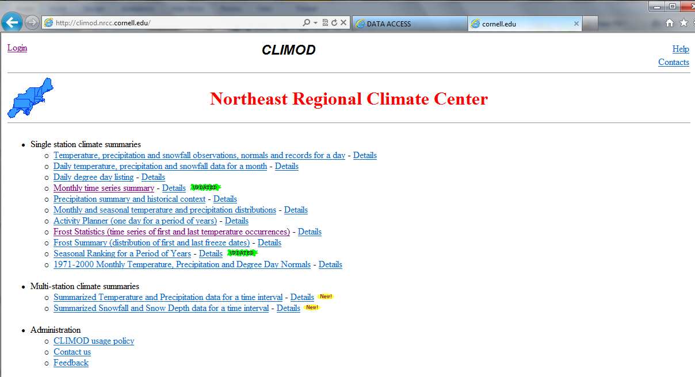
Other Sources of Climate Data for the jNSM
Regional Climate Centers have subscriptions to CLIMOD
NWS Cooperative Stations with records prior to 1900; complements the HCN records
Contains many discontinued weather stations in unique environments
A good source of many climate parameters in addition to the jNSM inputs—longer climate records and more easily downloaded
Six regional climate centers around the U.S.—Western, High Plains, Midwestern, Southern, Southeast, & Northeast
Regional Climate Centers have their own networks of automated weather stations available for shorter periods of record; often in unique environments

Slide 53
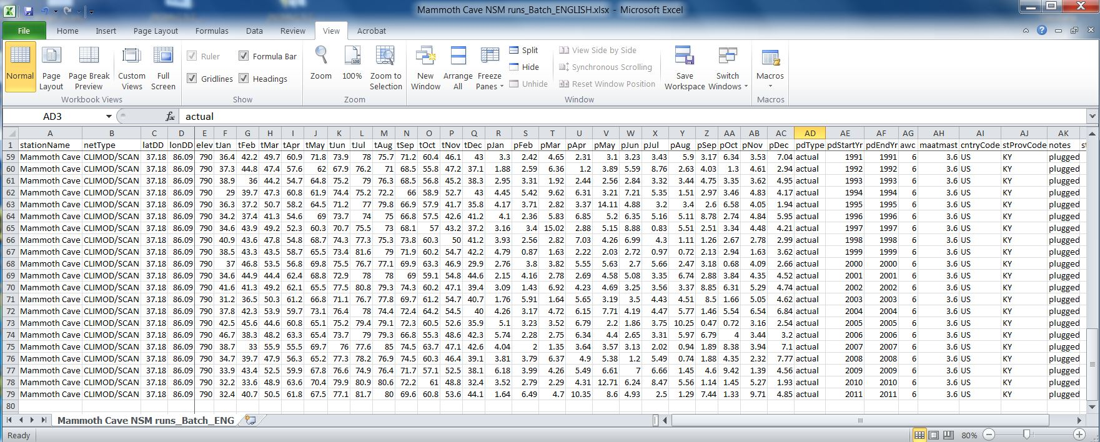
jNSM input file for Mammoth Cave National Park 1934-2000 climate record
…
Notes:
Here is what the jNSM input file (using the ENGLISH template) would look like for the long term (1934-2011) climate record for Mammoth Cave. Note the AWC value is 6 inches and the maatmast offset value is 3.6 degrees F.
When we run the long term average (1934-2011) or the 1971-2000 30 year Normal record, there would be just a single line in the jNSM input table for this summary of years.

Slide 54
Mesic
3.6ºF offset applied to mean annual air temperature at NWS cooperative weather station site
Notes:
The MAST can be plotted through time by adding the SCAN derived offset value to MAAT. This allows the soil scientist to extent this offset estimate over a longer period of climate record. In this case the CLIMOD climate record scans 1934 to 2011 or 78 years. jNSM also computes the MAST by addition of the offset value supplied by the user to MAAT. If the offset is not known, a default of 2.5 degrees C (4.5 degrees F) can be used by jNSM.

Slide 55
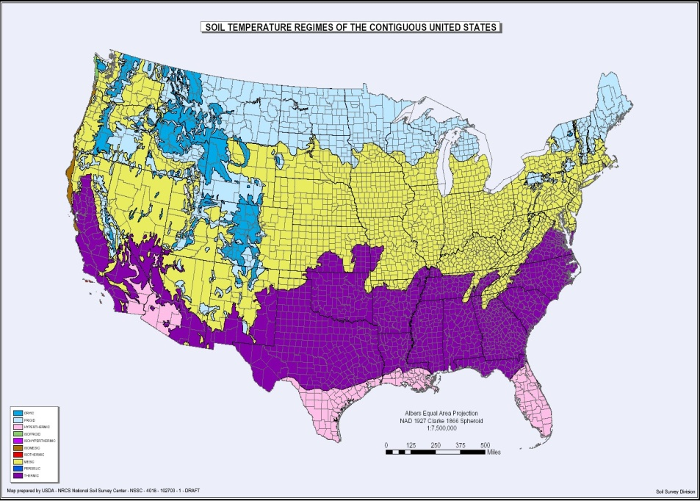
Soil Climatology at Mammoth Cave National Park, KY (1934-2011)
Soil Moisture Regimes Years %Freq AWB SWB
(mm) (mm)
Mammoth Cave NP
Typic Udic 45 58% +592 -38
Dry Tempudic 23 29% +456 -156
Wet Tempustic 7 9% +294 -230
Typic Xeric 3 4% +235 -279
Mean +511 -99
Soil Temperature Regimes
Mesic 14 18% +576 -65
Thermic 64 82% +497 -107
Mammoth Cave
Notes:
The CLIMOD record and SCAN offset value were used as inputs for jNSM model was runs for each of the 78 years (1934 to 2011). Based on the model results, frequencies of soil moisture and temperature regimes were summarized for this climate record. Mammoth Cave NP, KY CLIMOD climate record (1934-2011) was input into jNSM and soil moisture and temperature regimes were estimated for each of the 78 years. The table illustrates the number of years and percent frequency during this period of time that the temperature regimes shift from the hypothesized Mesic, Udic regimes. The site is 58% Typic Udic, 29% Dry Tempudic, 7% Wet Tempustic, and 3% Xeric. The site is also 18% Mesic and 82% Thermic for this same period of time. The 10 non-Udic years were either Ustic or Xeric and could be indicators of drought events.

Slide 56
Mammoth Cave Climate Records and Drought Years –
Timeline Comparisons
Soil Climate Analysis Network or SCAN (2004 -2 011) – Daily Air Temp and 50cm Soil Temp
Northeast Regional Climate Center CLIMOD (NWSCOOP) (1934 – 2011) - Monthly Air Temp and Precip
US Historical Climatology Network (1895 – 2011) - Daily and Monthly Air Temp and Precip
NWS COOP Network 30 year Normal (1971 - 2000) Monthly Air Temp and Precip
Nationally significant drought events – National Drought Mitigation Center, 2012
Ustic Years
Xeric Years
1895
1900
1934
1971
2000
1952-53
2004
2011
1936
1945
1963
1968
1983
1999
2007-08
8 yrs
78 yrs
117 yrs
30 yr Normal
1870
1880
1890
1910
1920
1930
1940
1950
1960
1970
1980
1990
2010
2020
Tree ring
records
Dust Bowl Years
Notes:
The Ustic years are shown by a golden starburst and the Xeric years are shown by a pink starburst. Ustic years are 1935, 1945, 1952, 1963, 1968, 2007, and 2008. The Xeric years are 1953, 1983, and 1999. We will examine the jNSM Soil Climate Calendar report and Climograph for the Xeric 1999 year.

Slide 57
Notes:
Note: MAST = MAAT + 2 degrees C. AWC is 152 mm. This was also a Thermic year. Note the number of Dry in SMCS days (shown in red) in the Soil Moisture Calendar. Moist days are shown in green and Moist/Dry days are shown in tan.

Slide 59
Utilization
Moisture Regime: Udic
Temperature Regime: Themic
jNSM Subgroup Modifier: Typic Udic
Surplus
Recharge
PREC < PET in Jun-Jul-Aug
Mean Annual Precipitation = 1321 mm (51.99 in) BIO5 = 245 d
*Growing Season Precipitation_{(Apr-Sep)} = 655 mm (25.80 in) BIO8 = 221 d
Annual Water Balance = 511 mm (20.12 in) Total Dry Days = 9 d
Summer Water Balance = -99 mm (3.90 in) Total Moist/Dry Days = 28 d
Mean Annual PET = 795 mm (31.30 in) Total Moist Days = 323 d
Notes:
Here is the long term climograph for Mammoth Cave NP (78 years from 1934 to 2011). This long term summary classifies as Udic and Thermic. The jNSM subgroup modifier is Typic Udic. Note all parameters except * Growing Season Precipitation are provided in the jNSM output XML file.

Slide 61
Notes:
Based on 78 jNSM runs for individual years (1934-2011) plus long term average for this period as well as the 30 year Normal (1971-2000), the Mammoth Cave NP station has Moisture Regimes that are most often Udic, with some Ustic and Xeric years and Temperature Regimes that are most often Thermic, with some Mesic years.

Slide 62
Notes:
There are also promising applications of the jNSM geospatially using the PRISM 800 resolution 1971-2000 monthly precipitation and air temperature information as input. This diagram illustrates how a jNSM input record could be extracted for a single 800m x 800m cell. A DEM and a soils layer of root zone available water capacity (from STATSGO2 or SSURGO) also provide needed input parameters for each cell. There are about 12 million 800m x 800m cells in the Conterminous US. This would require about 12 million jNSM runs, one for each cell. The output parameters from the jNSM model run, can then be mapped back to each cell for geospatial evaluation and mapping.

Slide 63
Notes:
This work is in process by Purdue University PhD candidate Edwin Winzler, Dr. Phillip Owen, Dr. Zamir Libohova, Dr. William Waltman, and Sharon W. Waltman. Early results should be available in late 2012. The preliminary Summer Water Balance (swb) map layer is shown for the area near Bowling Green, KY. The 1971-2000 NWSCOOP weather station locations and swb values are also mapped. The red arrows indicate the location of the Bowling Green FAA AP and the swb value calculated by jNSM plus the preliminary PRISM based swb map layer.

Slide 64
Summary and Conclusions
jNSM is adapted to mesoscale modeling of soil climate regimes with limited data; can be used with PRISM datasets or TAPS/WETLANDS tables, or with HCN sites; applicable to modeling National Parks, MLRAs, & Wildlife Refuges
From jNSM, coupled parameters of soil climate can be derived—annual water balance, summer water balance, growing season water balance, biological windows at 5ºC and 8ºC; frequency of events; building drought histories
Handles local/regional Air/Soil temperature offsets and root zone available water-holding capacity
Tradeoff—relies upon a less robust PET approach (thermal vs. biophysical), but it has broader geospatial applicability to remote areas with few stations or limited sensor data
Helps us better understand the polyclimatic character of soil landscapes and climate-driven soil processes

