Slide 1
Urban/Small Farm Scenarios
Robert D. Evans (Bobby), State Resource Conservationist

Slide 2
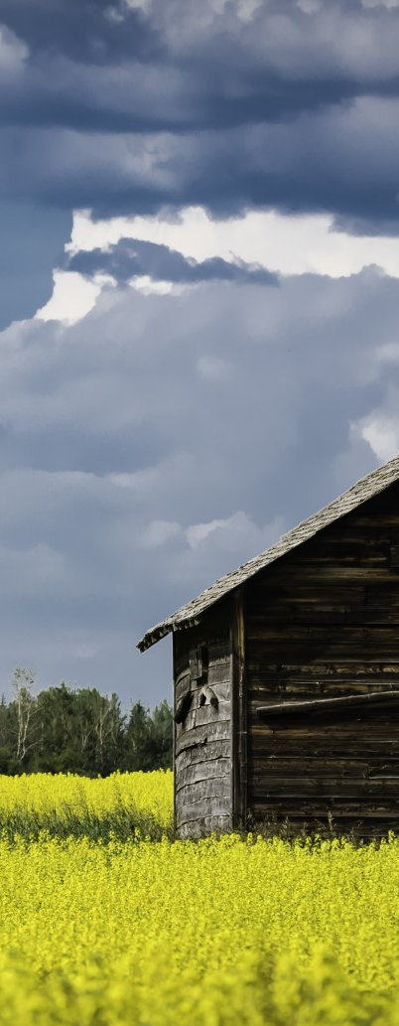
New Small Farm Scenarios
Practice Name | Code
Alley Cropping | 311
Brush Management | 314
Herbaceous Weed Treatment | 315
Composting Facility | 317
High Tunnel System | 325
Conservation Cover | 327
Conservation Crop Rotation | 328
Residue and Tillage Management, No-Till | 329
Cover Crop | 340
Critical Area Planting | 342
Residue at Tillage Management, Mulch-Till | 345
Windbreak/Shelterbelt Establishment and Renovation | 380
Fence | 382
Field Border | 386
Wildlife Habitat Planting | 420
Irrigation Pipeline | 430
Irrigation Reservoir | 436
Irrigation System, Microirrigation | 441
Sprinkler System | 442
Practice Name | Code
Surface & Subsurface Irrigation System | 443
Irrigation Water Management | 449
Land Leveling | 464
Tree/Shrub Site Preparation | 490
Pasture and Hay Planting | 512
Livestock Pipeline | 516
Prescribed Grazing | 528
Roof Runoff Structure | 558
Stormwater Runoff Control | 570
Trails and Walkways | 575
Nutrient Management | 590
Pest Management System | 595
Tree/Shrub Establishment | 612
Water Harvesting Catchment | 636
Tree/Shrub Pruning | 660
Soil Carbon Amendment | 808
Raised Beds | 812
Low Tunnel Systems | 821
Links: EQIP Payment Schedule & Scenario Descriptions

Slide 3
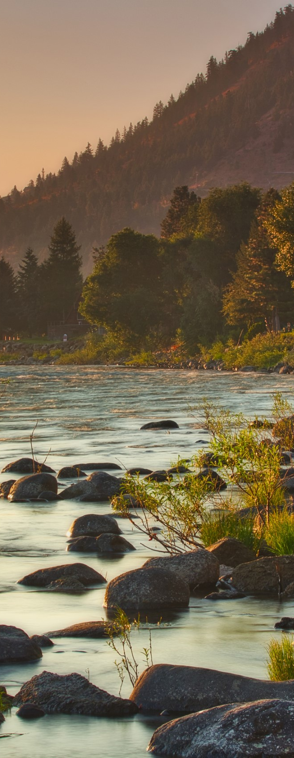
Interim Conservation Practices
Soil Carbon Amendment (808)
Raised Bed (812)
Low Tunnel System (821)
Amending Soil Properties with Lime (805)

Slide 4
Questions?

