Slide 1
NRCS Programs Update
March 23, 2023

Slide 2
Inflation Reduction Act (IRA)
No IRA funds will be disbursed after 9/30/2031
Provides $20 billion to support USDA’s conservation programs that yield climate-related benefits while building resilience in agricultural operations. (For practices, enhancements and activities that improve soil carbon, reduce nitrogen losses, or reduce, capture, avoid, or sequester CO2, methane, or NOx emissions associated with ag. production)
$8.45 billion for the Environmental Quality Incentives Program
FY23- $250 million
FY24- $1.75 billion
FY25- $3.0 billion
FY26- $3.45 billion
$3.25 billion for the Conservation Stewardship Program
FY23- $250 million
FY24- $500 million
FY25- $1.0 billion
FY26- $1.5 billion
IRA Law _ https://www.congress.gov/117/plaws/publ169/PLAW-117publ169.pdf
$1.4 billion for the Agricultural Conservation Easement Program (for easements or interests in land that will most reduce, capture, avoid, or sequester CO2, methane or NOx emissions associated with land eligible for the program)
FY23- $100 million (EPD said most of this FY’s $ would be pushed to FY24)
FY24- $200 million
FY25- $500 million
FY26- $600 million
$4.95 billion for the Regional Conservation Partnership Program (shall prioritize partnership agreements that support the implementation of conservation projects that assist… )
FY23- $250 million
FY24- $800 million
FY25- $1.5 billion
FY26- $2.4 billion
$1 billion for conservation technical assistance
$300 million to measure, evaluate, quantify carbon
sequestration and greenhouse gas emission reductions from conservation investments
Notes:
There will be additional updates provided to OTAC as the specifics are provided on IRA funding.
There are several meetings this week on the subject, and we are hopeful details will be provided soon.
USDA has requested public feedback via the Federal Register on the implementation of IRA. NRCS has asked for comments on how to target program benefits, quantify impacts, and improve program delivery and outreach.
Comments are due December 21, 2022

Slide 3
Oregon-Inflation Reduction Act (IRA) Forecast
IRA funding is in addition to OR’s regular FB funding
Financial Assistance funds dispersed to states FY23-FY26
Funds will be expended by 9/30/2031
Environmental Quality Incentives Program- Financial Assistance
FY23- $2.1 million
FY24- $13 million
FY25- $23 million
FY26- $26 million
Conservation Stewardship Program- Financial Assistance
FY23- $4.8 million
FY24- $7.5 million
FY25- $15.2 million
FY26- $23 million
Agricultural Conservation Easement Program (for easements or interests in land that will most reduce, capture, avoid, or sequester CO2, methane or NOx emissions associated with land eligible for the program)
FY23- $0
FY24- $0
FY25- $6.7 million
FY26- $8 million
Notes:
Baseline EQIP approximately $20million/yr, Baseline CSP approximately $18 million/yr.

Slide 4
IRA uses Climate- Smart Agriculture and Forestry (CSAF) Mitigation Activities
NRCS climate-smart agriculture and forestry mitigation practices are divided into mitigation categories and delivered through NRCS programs such as EQIP and CSP
Soil Health – Reducing emissions and enhancing soil carbon sequestration.
Nitrogen Management – Implementing the 4Rs of nitrogen management and reducing nitrous oxide, a potent greenhouse gas. The 4Rs are Right Source, Right Rate, Right Time and Right Place.
Livestock Waste Management – Reducing potent methane emissions from manure.
Grazing Land Management – Reducing emissions and building soil carbon stocks in grazing systems.
Agroforestry, Forestry and Upland Wildlife Habitat – Building carbon stocks in perennial biomass and soils.
Restoration of Disturbed Lands – Improving the quality of previously mined or degraded lands to increase soil and perennial biomass carbon stocks.
Rice Production – Reducing methane emissions from rice fields by minimizing methane production during the growing season.
https://www.nrcs.usda.gov/conservation-basics/natural-resource-concerns/climate/climate-smart-mitigation-activities

Slide 5
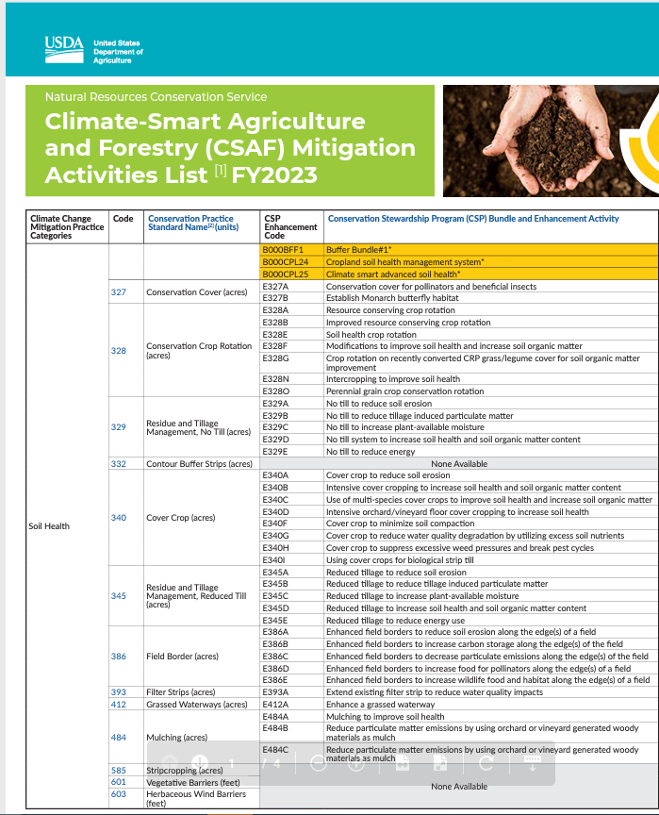
IRA supported Climate Smart Agriculture and Forestry (CSAF)
The full CSAF list can be viewed here:
https://www.nrcs.usda.gov/conservation-basics/natural-resource-concerns/climate/climate-smart-mitigation-activities
5

Slide 6
Agricultural Conservation Easement Program (ACEP)
Notes:
GO TO VIEW > MASTER > SLIDE MASTER TO EDIT THE IMAGES ON THE TITLE AND DIVIDER SLIDES

Slide 7
ACEP Components
Agricultural Land Easements (ACEP-ALE)
NRCS provides cost-share assistance to eligible entities for the purchase of agricultural land easements on eligible land from eligible landowners. Entity holds the easement.
Purpose of ALE
Protect the agricultural use, viability and related conservation values of eligible land by limiting non-agricultural uses.
Protect grazing uses and related conservation values by restoring and conserving eligible land.

Slide 8
ACEP Components
Wetland Reserve Easements (ACEP-WRE)
NRCS purchases easements directly from eligible landowners through a reserved interest deed on eligible land to restore, protect, and enhance wetlands and associated habitats. NRCS holds the easement.
Purpose of WRE
Restore, protect, and enhance wetlands on eligible land while maximizing wetland wildlife habitat.

Slide 10
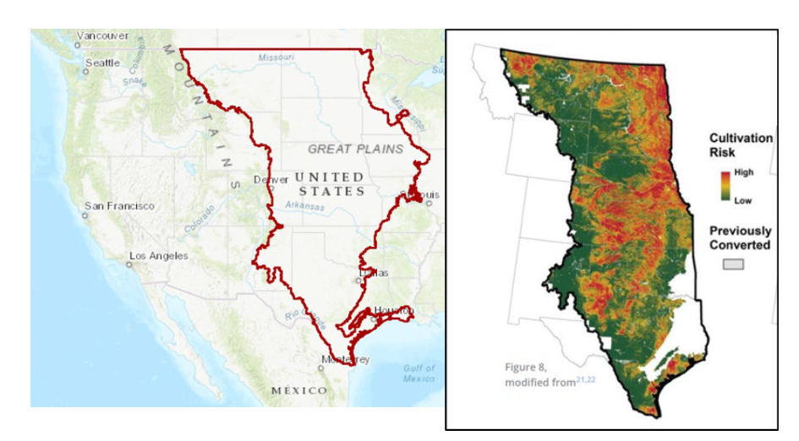
FY 2023 IRA ACEP-ALE Prioritization

Slide 11
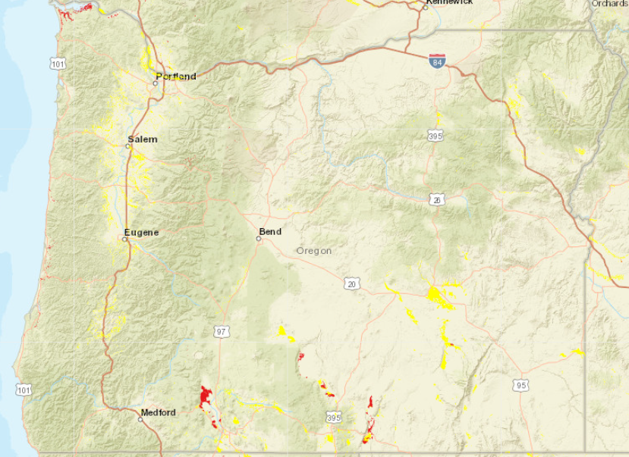
FY 2023 IRA ACEP-WRE Prioritization
FY24- Developing state strategy to compete for national IRA ACEP ALE/WRE funding

Slide 12
ACEP-ALE Update
Successful partnership with Oregon Watershed Enhancement Board (OWEB) through Oregon Agricultural Heritage Program (OAHP)
Can provide match funding for ACEP-ALE through annual application process
Fiscal Year | Application # | Agreement # | Obligation
FY22 | 9 | 8 | $7,300,000
FY23 | 4 | 3 | $1,780,143
Fiscal Year | Application # | Forecasted Need
FY24 | 10 | $5,800,000

Slide 13
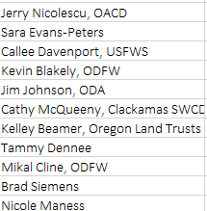
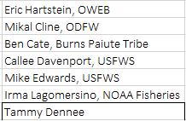
ACEP-WRE
Future Sub-Committee Requests
FY24 Geographic Area Rate Cap (GARC) review (85% of FMV for FY23)
WRE Ranking Updates
Wetlands Restoration Conservation Guide (WRCG) Input and Review
WRE advertisement, outreach, success stories
Contact Cory Owens or Erin Kaczmarczyk for updates to OTAC Easement or WLFW sub-committee member updates

Slide 14
USDA Non-Discrimination Statement
In accordance with Federal civil rights law and U.S. Department of Agriculture (USDA) civil rights regulations and policies, the USDA, its Agencies, offices, and employees, and institutions participating in or administering USDA programs are prohibited from discriminating based on race, color, national origin, religion, sex, gender identity (including gender expression), sexual orientation, disability, age, marital status, family/parental status, income derived from a public assistance program, political beliefs, or reprisal or retaliation for prior civil rights activity, in any program or activity conducted or funded by USDA (not all bases apply to all programs). Remedies and complaint filing deadlines vary by program or incident.
Persons with disabilities who require alternative means of communication for program information (e.g., Braille, large print, audiotape, American Sign Language, etc.) should contact the responsible Agency or USDA's TARGET Center at (202) 720-2600 (voice and TTY) or contact USDA through the Federal Relay Service at (800) 877-8339. Additionally, program information may be made available in languages other than English.
To file a program discrimination complaint, complete the USDA Program Discrimination Complaint Form, AD-3027, found online at How to File a Program Discrimination Complaint and at any USDA office or write a letter addressed to USDA and provide in the letter all of the information requested in the form. To request a copy of the complaint form, call (866) 632-9992. Submit your completed form or letter to USDA by: (1) mail: U.S. Department of Agriculture, Office of the Assistant Secretary for Civil Rights, 1400 Independence Avenue, SW, Washington, D.C. 20250-9410; (2) fax: (202) 690-7442; or (3) email: program.intake@usda.gov.

