Slide 1
Regional Conservation Partnership Program
OTAC March 23

Slide 2
Goals:
Current Status of RCPP in Oregon
New RCPP Projects
IRA Projections
RCPP Improvement Process and new NFO

Slide 3
4 Pillars of RCPP
RCPP
Impact
Partner Contributions
Innovation
Project Management

Slide 4
4 Pillars of RCPP
RCPP
Impact
Contributions
Innovation
Project Management
…..and, RCPP18 (so far) is not a grant - It’s a partnership project using NRCS tools.

Slide 5
Oregon RCPP - Highlights
In Oregon, We have a portfolio of projects that are making an impact at landscape & watershed scales.
RCPP 2015-2023
37 Projects
$103 million in NRCS funding allocated
~$154 million in partner contributed funds
= > $250 million invested in strategic conservation
Current 2023 RCPP
24 Projects
$62 million in NRCS funding, $103 million partner contributions

Slide 6
RCPP in 2022
4 New Farm Bill 2018 RCPPs
2 Renewals
76 Contracts across 8 RCPPs
$4 million in obligated landowner contracts

Slide 7
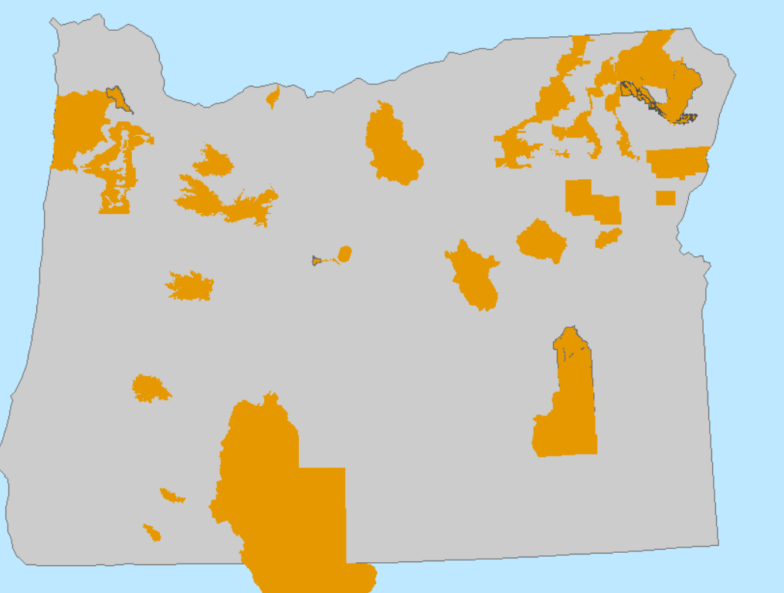

Slide 9
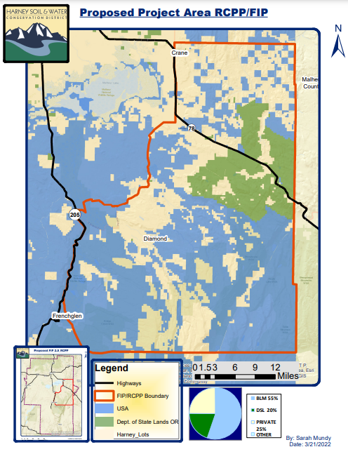
New RCPP Project: Northern Steens
Lead Partner: Harney SWCD
Resource Concerns: Terrestrial Habitat
Goals: Reduce primary threats to Greater sage-grouse and improve habitat quality and quantity by accelerating implementation of conservation actions on private lands through the USFWS Candidate Conservation Agreements with Assurances (CCAA)
NRCS Amount: $3,292,207
Partner Contribution: $7,867,551.00

Slide 10
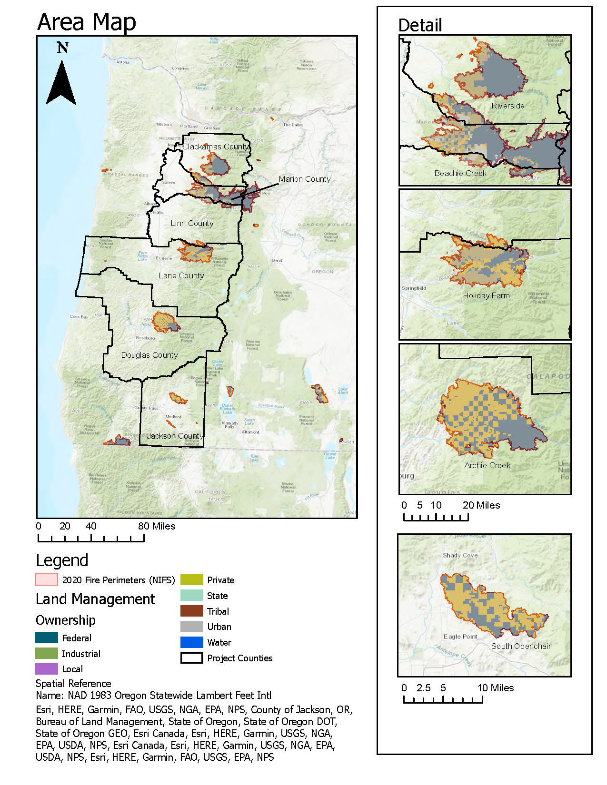
New RCPP Project: Western Oregon Cascades Recovery Effort
Lead Partner: Sustainable NW
Resource Concerns: Degraded plant condition, water quality, habitat, soils.
Goals: Provide private landowners with aggregated contracts for wildfire assistance.
This is an AFA
NRCS Amount: $5,000,000.00
Partner Contribution: $7,867,551.00

Slide 11
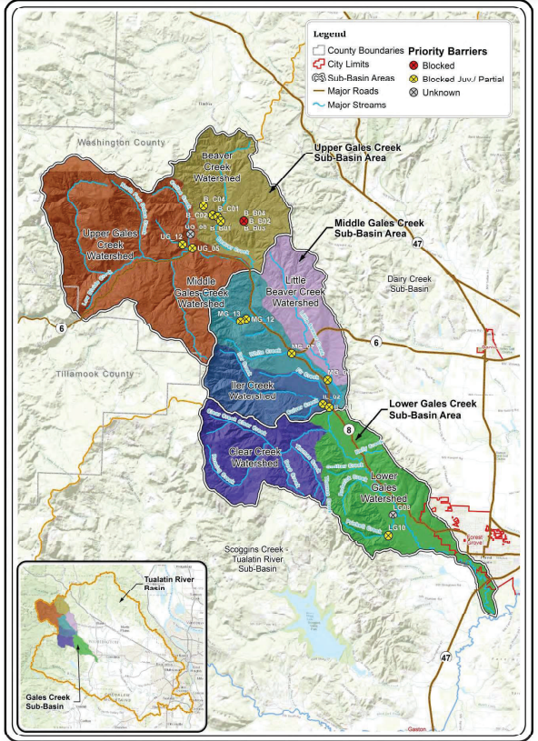
New RCPP Project: Tualatin Basin Habitat Conservation Partnership
Lead Partner: Tualatin SWCD
Resource Concerns: Aquatic Habitat
Goals: Remove key fish passage barriers in the watershed to open up salmon habitat.
This is an AFA
NRCS Amount: $1,493,674.00
Partner Contribution: $1,929,339.00

Slide 12
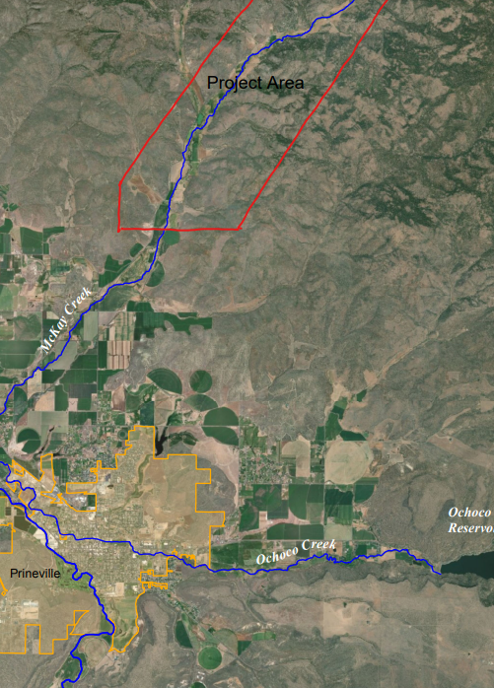
New RCPP Project: McKay Creek On-Farm Modernization
Lead Partner: Deschutes River Conservancy
Resource Concerns: Water quantity, aquatic habitat
Goals: Provide private landowners with on-farm pressurized irrigation to support the McKay switch project.
NRCS Amount: $1,214,286.00
Partner Contribution: $1,496,498.00

Slide 13
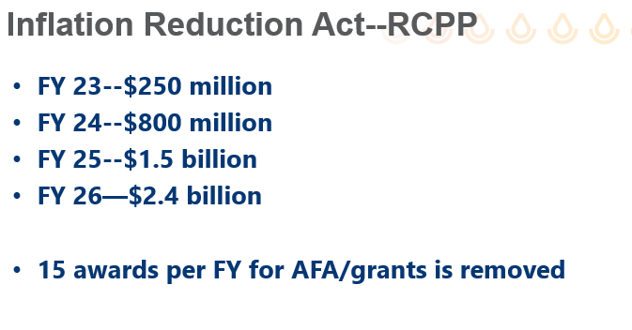
National RCPP Program
$300m / year – Farm Bill18 (TBD FB23/24)
+

Slide 14
RCPP Improvement Process
Partners have identified that RCPP:
High administrative costs
Complex administrative requirements
Delays in contract executions
Ambiguity in NRCS staff roles
Technical issues with software
A national team has been convened to address these issues for the next NFO, and for future RCPP operations.

Slide 15
The Next Notice of Funding Opportunity
This spring – mid to late April.
~$500 million nationally
There will be a single NFO with:
RCPP-Classic (“not a grant”)
AFA (“more like a grant”)
IRA (“grant/cooperative agreement?”)
TAKEHOME MESSAGE: Lots of RCPP Resources in the future. We will improve program delivery to make it more “user friendly” for partners & staff. Oregon is a leader in building successful RCPPs

Slide 16
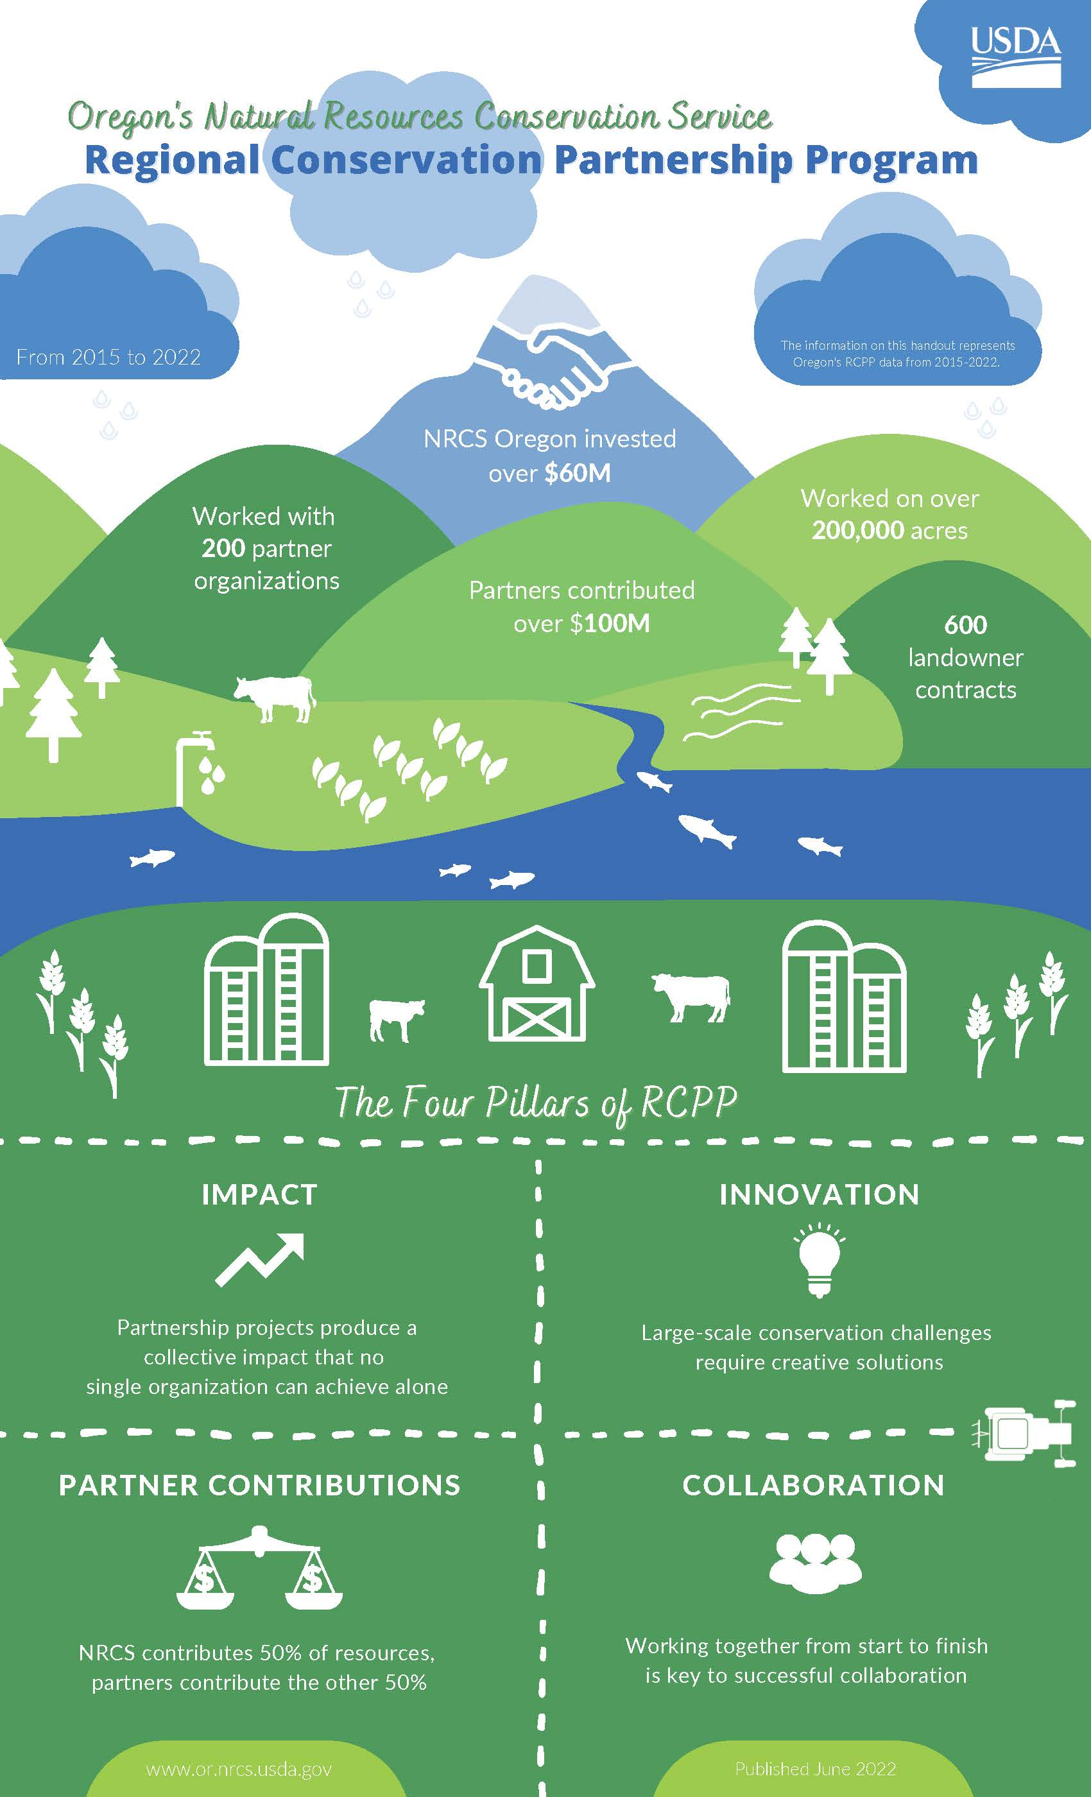
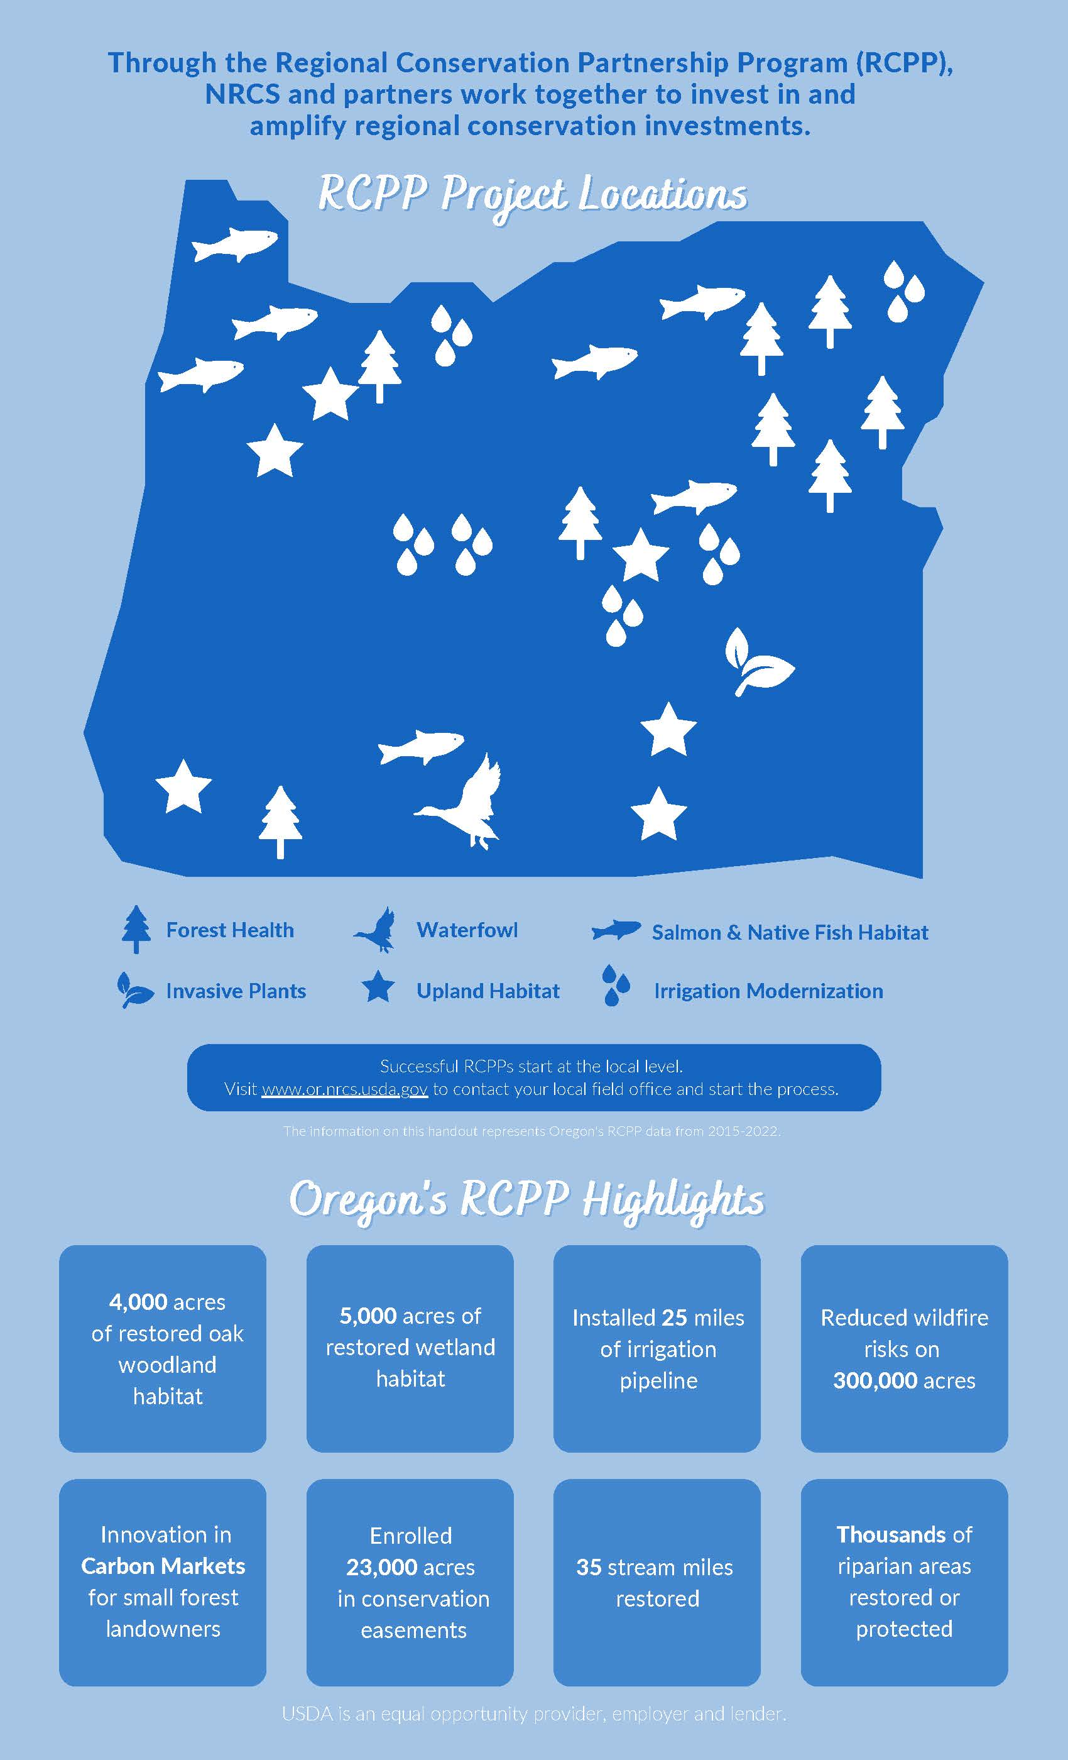
Thank You and Questions

