Slide 1
EQIP High Priority Practices (“Top 10”)
Presenter: Robert D. Evans (Bobby), SRC

Slide 2
Overview
Review Current List
Discuss Strategy
Proposed Changes
SRA-OBP & KPI Impacts
Source Water Protection Analysis
Riparian Buffer Program Impacts
Key Points

Slide 3
FY23 High Priority Practices

Slide 4
General Strategy
Promote soil health
National objective initiative
Improve water quality
Statewide importance to Washington
Reduce sedimentation
Nutrient runoff
Incentivize management practices
Can be planned multiple years
Consider impacts
SRA-OBP
KPIs
SWPA
RBP

Slide 5
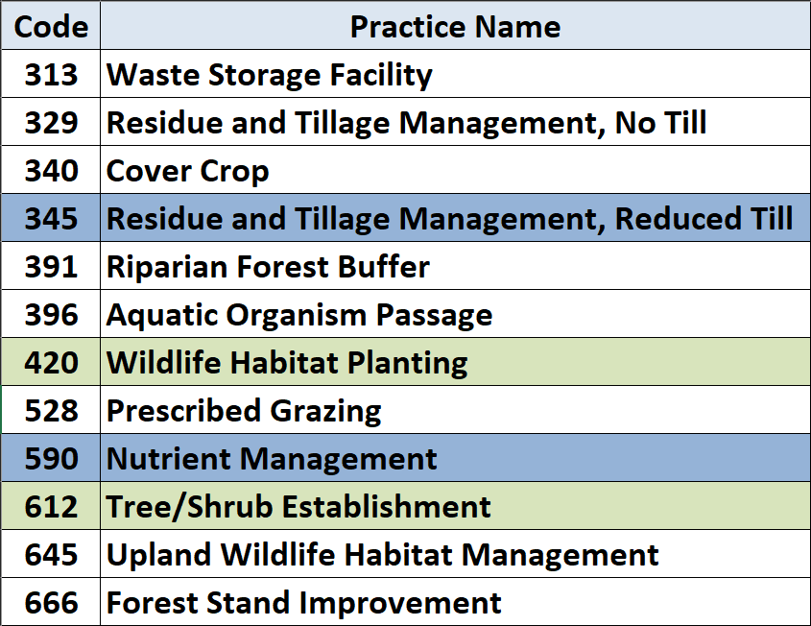
Keep, Drop, & Add
Add
Keep
Drop

Slide 6
Impacts to SRA-OBP & KPIs
KPIs & SRA-OBP impact NRCS-WA overall annual budget
345 & 590 benefit Measure 1.10 for Cropland vs 420 & 612
345 benefits 1.13 Soil Health Mgmt Systems
3.40 practices 420 & 612 are likely to be ‘pancaked’
Not much progress to date for 420 & 612
420 & 612 likely to be adopted regardless of Priority Rate
Smaller acreage practices, Less impact to incentive
Keep
Add
Drop

Slide 7
Source Water Protection Area
Both 345 (no-till) & 590 (NMP) are SWPA practices
Notes:
Map was created by input from heads of Ecology & EPA. Adding 345 & 590 will protect source water outside of this limited area.

Slide 8
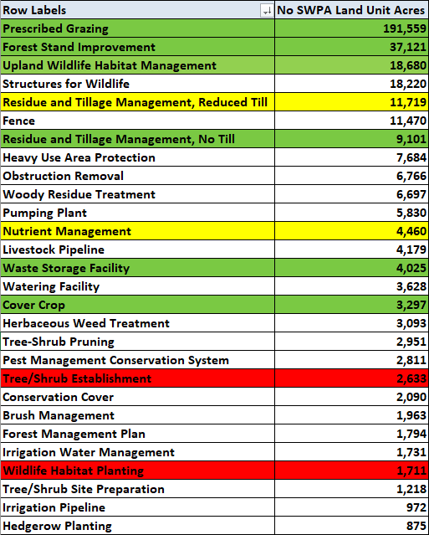
Progress with & without SWPA Counties
24.3%
36.1%

Slide 9
Small Impact to Riparian Buffer Program
Tier 2. Native perennial herbaceous cover
Analysis:
420 still part of SPWA (WP) practices
Only a -$52.04/ac reduction for non-SWPA

Slide 10
Pros & Cons
Pros:
345 & 590 are both IRA practices
345 & 590 improve KPIs
1.10 & 1.13 Performance Measures
345 & 590 are both mgmt practices
Can be planned multiple years
Cons:
420 is part of RBP’s tier 2 (-$52.04)
Still part of Source Water Protection
Bulk of payment is tied to 645 mgmt practice

Slide 11
Questions?

