Slide 1
Proposed CSP Zone changes for FY24
Keith Griswold, Assistant State Conservationist for Programs

Slide 2
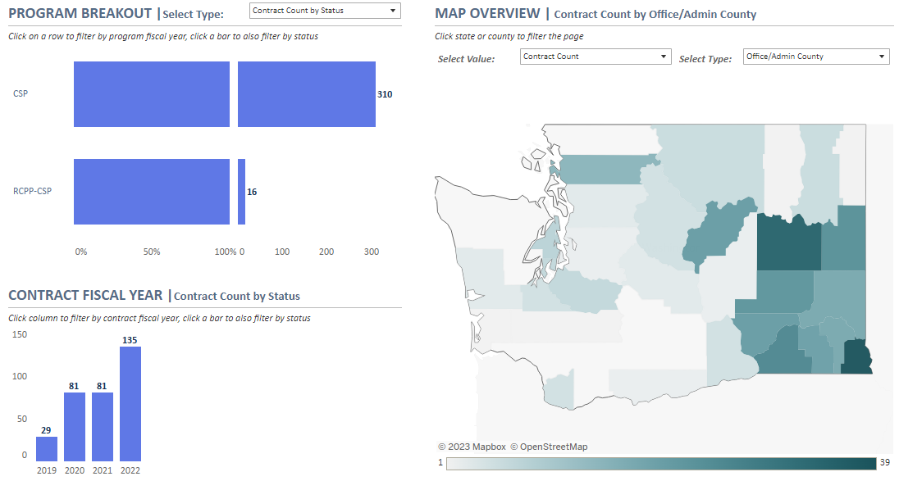
What is WA’s current CSP contract workload?

Slide 3
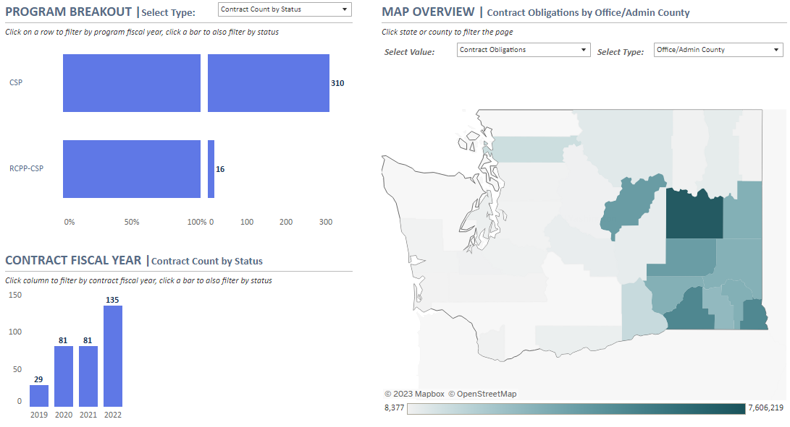
What is the CSP contracting total value?

Slide 4
Current CSP Zones

Slide 5
FY24 Proposed CSP Zones by Area boundaries

Slide 6
No change to NIPF fund pool
NIPF fund pool is statewide for forestry only
This is required by statute

Slide 7
Each Area will have its own CSP fund pool to compete against
Leftover Area funds can be moved to other areas to fund additional applications
Try to spread the CSP workload and funds more evenly where possible
Other states use administrative boundaries as ranking pools, WA is not going out on limb (ID, CO, CA).
51% of land base location determines what Area to rank in.
Allows AC’s to actively manage CSP workload

Slide 8
QUESTIONS

