Slide 1
Grasslands of Special Significance (GSS)
Keith Griswold, Assistant State Conservationist for Programs

Slide 2
Background information
The Agricultural Conservation Easement Program (ACEP) Grasslands of Special Environmental Significance (GSS) areas are eligible for an increased Federal share for enrollment of GSS land that protects the long-term grazing uses and related conservation values on eligible private range and pasture lands.
The program emphasizes support of grazing operations, maintaining and improving plant and animal biodiversity, and protecting grasslands and shrublands under threat of conversion to cropping, urban development, and other non-grazing uses.

Slide 3
Policy information
Conservation Programs Manual (CPM) Title 440.528.33 B(3)(iii)
(iii) Grassland of special environmental significance, which is defined in 7 CFR Section 1468.3 as grasslands that contain little or no noxious or invasive species, as designated or defined by State or Federal law; are subject to the threat of conversion to nongrassland uses or fragmentation; and the land is—
• Rangeland, pastureland, shrubland, or wet meadows on which the vegetation is dominated by native grasses, grass-like plants, shrubs, or forbs, or is improved, naturalized pastureland, rangeland, or wet meadows.
• And the land provides, or could provide, habitat for threatened or endangered species or at-risk species, protects sensitive or declining native prairie or grassland types or grasslands buffering wetlands, or provides protection of highly sensitive natural resources as identified by the State conservationist, in consultation with the State technical committee.

Slide 4
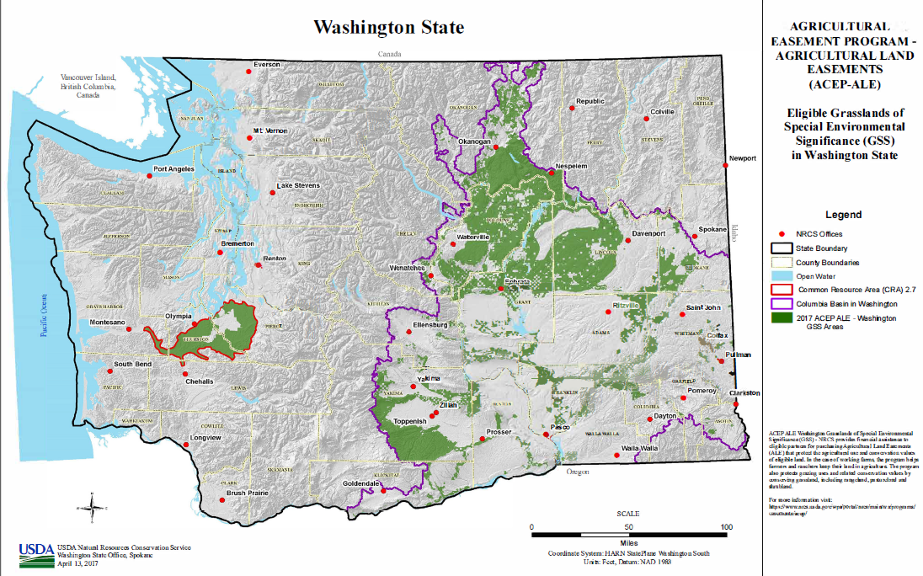
Current area of GSS in WA

Slide 5
Request for additional information
On March 30, 2023 NRCS sent out email to STAC members asking for additional prairie habitat information. NRCS is looking for geospatial data to evaluate prairie habitat in Washington to potentially expand our easement program eligibility and availability for FY24.

Slide 6
Questions?

