Slide 1
NWQI
Nick Vira

Slide 2
National Water Quality Incentive Program

Slide 3
NWQI – Overview
Purpose: Reduction of sediment, nutrients, & pathogens in ground & surface water
Project Area: 12-digit HUC
Cooperating Partners (primary):
  WA Dept of Ecology
  Environmental Protection Agency
  Individual Conservation Districts
  Local Work Groups

Slide 4
NWQI – Phases
Planning Phase
Implementation Phase

Slide 5
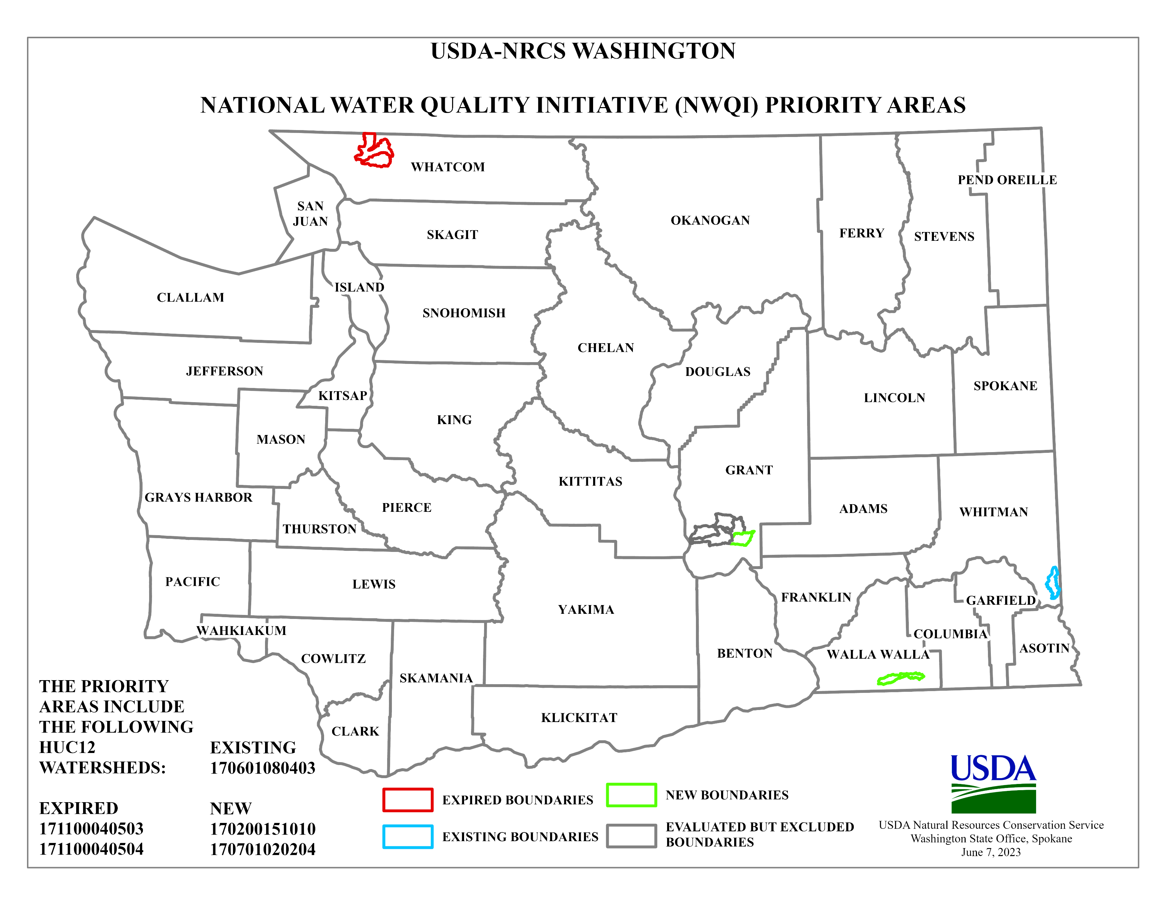
Implementation Phase ($$)

Slide 6
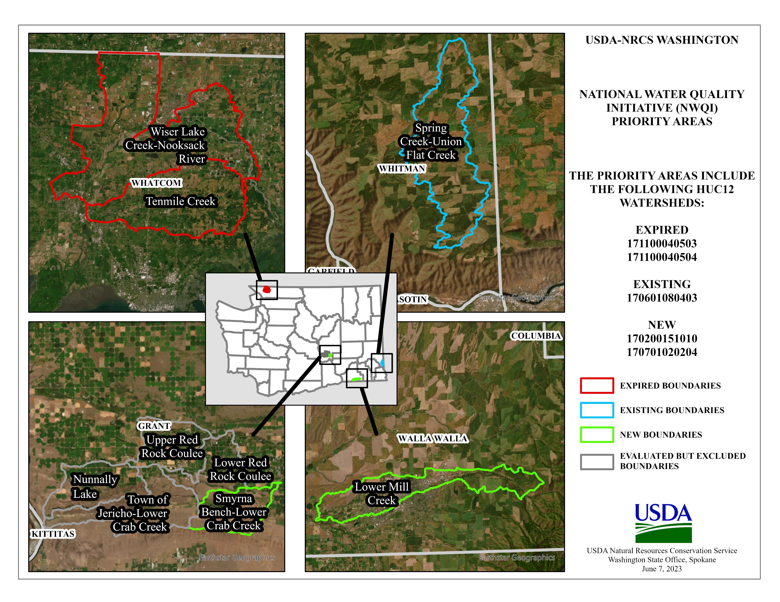
Implementation Watersheds

Slide 7
Implementation Phase Watersheds
Financial Assistance Requests:
Crab Creek - $1million
Spring Creek / Union Flats - $300,000
Mill Creek - $250,000

Slide 8
Planning Phase
None selected this year due to New Implementation phases watersheds
Next Year – will use Local Work Group Process to identify Planning Phase watersheds for consideration

Slide 9
Questions?
?

