Slide 1
Paid Parental Leave
Fay Hill, Supvy Benefits and Retirement Team and leave program Manager

Slide 2
Paid Parental Leave Objectives
To Learn the Guidelines of the newly approved Paid Parental Leave
To Discuss questions on how to apply Paid Parental Leave

Slide 3
Regulations
Title 5 of the United State Code of Federal Regulations, 5 CFR 630
5 U.S.C. 6382

Slide 4
History of Paid Parental Leave
On December 20, 2019, President Trump signed into law a major improvement to the compensation and benefits package for Federal civilian employees as part of the National Defense Authorization Act for Fiscal Year 2020 (Public Law 116-92).
The new law amended the Family and Medical Leave Act (FMLA) provisions in title 5, United States Code, 6382 to provide up to 12 weeks of paid parental leave to covered Federal employees in connection with the birth or placement (for adoption or foster care) of a child occurring on or after October 1, 2020. By specific provision in the Act, paid parental leave will be provided in connection with a birth or placement occurring on or after October 1, 2020.
Paid parental leave granted in connection with a qualifying birth or placement is substituted for unpaid FMLA leave and is available during the 12-month period following the birth or placement.

Slide 5
Paid Parental Leave
Mothers and Fathers can use Paid Parental Leave (PPL) if they are eligible for FMLA. (Must have 12 months of Federal service.) Eligibility for FMLA did NOT change.
Starting October 1, 2020-PPL can be used. It cannot be used for time before Oct 1, 2020.
PPL is subject to the allowable FMLA period – 12 weeks in any 12-month FMLA period. Unused PPL can not be carried over.
If an employee has multiple children born or placed on the same day, the multiple childbirth/placement event is a single event that triggers a single entitlement of up to 12 weeks PPL.

Slide 6
Paid Parental Leave (Con’t)
If the employee has another separate placement or birth during a 12-month period, they are entitled to a second 12-month period of eligibility for PPL that start with the date of the second birth or placement of a child of the employee. Each event creates a new 12-week entitlement.
Any use of PPL during a given 12-month period will count toward that period's 12-week limit. When 12-month periods overlap, any use of PPL during the overlap will count against each affected 12-month period's 12-week limit.

Slide 7
Agency Administration of FEPLA
Agencies may not require employees to use AL or SL before allowing PPL.
Employees may use AL or SL in accordance with regulations without invoking FMLA to preserve their FMLA.
Employees must sign an agreement to return to work for 12 weeks following the leave. (Sample Letter at end of Presentation)

Slide 8
Limitations
PPL is a substitute for unpaid FMLA and use of FMLA leave for purposes other than birth or placement of a child (e.g., leave based on a serious health condition) during a 12-month FMLA period may reduce the FMLA leave available for birth or placement purposes.
The 12-week entitlement to PPL is applied on a per employee basis regardless of movement between different agencies during the 12-month period following birth, adoption or foster care placement.
Failure to complete the 12-week work obligation may result in an employee being required to make a reimbursement to the agency for the government contribution to the FEHB unless the agency determines that the employee is unable to return to work for the required 12 weeks due to:
The continuation, recurrence, or onset of serious health condition of the employee (including mental health) or the newly born or placed child but only if the condition is related to the applicable birth or placement
Any other circumstance beyond the employee’s control

Slide 9
Agency Administration of FEPLA (con’t)
Employees must provide a certification and appropriate documentation from a healthcare provider to their agency supporting the use of PPL.
Agencies shall allow PPL to be used intermittently.
NFC has provided new T&A codes available on October 1, 2020

Slide 10
Sample Agreement

Slide 11
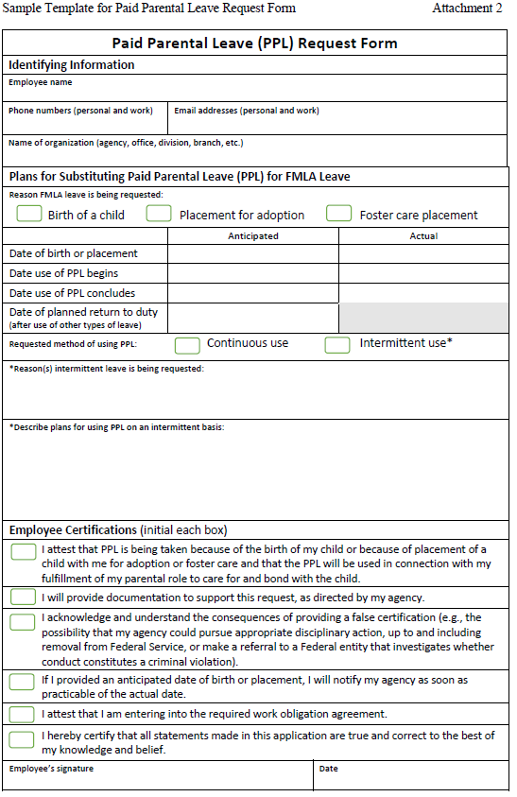
Paid Parental Leave - Request

Slide 12
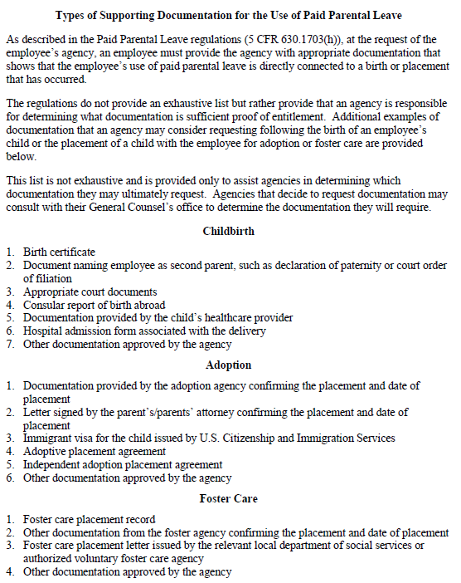
Supporting Documents

Slide 13
Helpful Links
FMLA FORMS:
https://www.dol.gov/sites/dolgov/files/WHD/legacy/files/WH-380-E.pdf
https://www.dol.gov/sites/dolgov/files/WHD/legacy/files/WH-380-F.pdf
CHCOC Guidance with the Request and Agreement Templates:
https://www.chcoc.gov/content/paid-parental-leave-federal-employees-interim-regulations

Slide 14
Questions

